Slide 1
Database Management System
Nishant Kumar

Slide 2
What is data?
Database is a collection of related data and data is a collection of facts and figures that can be processed to produce information.
Mostly data represents recordable facts. Data aids in producing information, which is based on facts. For example, if we have data about marks obtained by all students, we can then conclude about toppers and average marks.

Slide 3
File system
In a typical File System electronic data are directly stored in a set of files. If only one table is stored in a file, they are called flat files.
In files values are stored in each row separated with a special delimiter like commas.
In order to query some random data, first it is required to parse each row and load it to an array at run time. But for this file should be read sequentially (because, there is no control mechanism in files), therefore it is quite inefficient and time consuming.
And the second hurdle is to locate the files.
The user either has to perform each task manually or has to write a script that does them automatically with the help of the file management capabilities of the operating system.
These all issues with the file system leads to the serious issues of inconsistency, inability for concurrency, data isolation, threats on integrity and lack of security.

Slide 4
Database management system
A database management system stores data in such a way that it becomes easier to retrieve, manipulate, and produce information.
Traditionally, data was organized in file formats. DBMS was a new concept then, and all the research was done to make it overcome the deficiencies in traditional style of data management.

Slide 5
Characteristics
A modern database has the following characteristics
Real world entity
  A modern DBMS is more realistic and uses real-world entities to design its architecture. It uses the behavior and attributes too. For example, a school database may use students as an entity and their age as an attribute.
Relation based tables
  DBMS allows entities and relations among them to form tables. A user can understand the architecture of a database just by looking at the table names.
Isolation of data and application
  A database system is entirely different than its data. A database is an active entity, whereas data is said to be passive, on which the database works and organizes. DBMS also stores metadata, which is data about data, to ease its own process.
  A user is accessing data should not affect other users actions.

Slide 6
…
Less Redundancy
  DBMS follows the rules of normalization, which splits a relation when any of its attributes is having redundancy in values. Normalization is a mathematically rich and scientific process that reduces data redundancy.
  Same piece of data should not be present at two different places.
Consistency
  Consistency is a state where every relation in a database remains consistent. There exist methods and techniques, which can detect attempt of leaving database in inconsistent state. A DBMS can provide greater consistency as compared to earlier forms of data storing applications like file-processing systems.
  Any data written to the database must be valid according to all defined rules.

Slide 7
…
ACID Properties (Atomicity, Consistency, Isolation, and Durability)
  Atomic Transaction
    An atomic transaction is a series of database operations such that either all occur, or nothing occurs. Example: Airline Ticket Booking
  Consistency
    The guarantee that database constraints are not violated, particularly once a transaction commits
  Isolation
    Isolation determines how transaction integrity is visible to other users and systems.
      Serializable
      Repeatable Reads
      Read Committed
      Read Un-Committed
  Durability
    Guarantees that transactions that have committed will survive permanently.
    For example, if a flight booking reports that a seat has successfully been booked, then the seat will remain booked even if the system crashes.
    Durability can be achieved by flushing the transaction's log records to non-volatile storage before acknowledging commitment.

Slide 8
…
Multiuser and Concurrent Access
  DBMS supports multi-user environment and allows them to access and manipulate data in parallel. Though there are restrictions on transactions when users attempt to handle the same data item, but users are always unaware of them.
Multiple views
  DBMS offers multiple views for different users. A user who is in the Sales department will have a different view of database than a person working in the Production department. This feature enables the users to have a concentrate view of the database according to their requirements.
Security
  Features like multiple views offer security to some extent where users are unable to access data of other users and departments.
  DBMS offers methods to impose constraints while entering data into the database and retrieving the same at a later stage.
  For example, a user in the Sales department cannot see the data that belongs to the Purchase department. Additionally, it can also be managed how much data of the Sales department should be displayed to the user. Since a DBMS is not saved on the disk as traditional file systems, it is very hard for miscreants to break the code.

Slide 9
1 & 2 Tier architecture
Tier 1-
In 1-tier architecture, the DBMS is the only entity where the user directly sits on the DBMS and uses it. Any changes done here will directly be done on the DBMS itself. It does not provide handy tools for end-users. Database designers and programmers normally prefer to use single-tier architecture.
Tier 2-
If the architecture of DBMS is 2-tier, then it must have an application through which the DBMS can be accessed. Programmers use 2-tier architecture where they access the DBMS by means of an application. Here the application tier is entirely independent of the database in terms of operation, design, and programming.

Slide 10
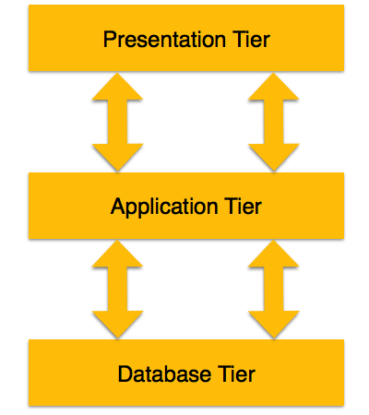
3-Tier architecture
Database (Data) Tier − At this tier, the database resides along with its query processing languages. We also have the relations that define the data and their constraints at this level.
Application (Middle) Tier − At this tier reside the application server and the programs that access the database. For a user, this application tier presents an abstracted view of the database. End-users are unaware of any existence of the database beyond the application. At the other end, the database tier is not aware of any other user beyond the application tier. Hence, the application layer sits in the middle and acts as a mediator between the end-user and the database.
User (Presentation) Tier − End-users operate on this tier and they know nothing about any existence of the database beyond this layer. At this layer, multiple views of the database can be provided by the application. All views are generated by applications that reside in the application tier.

Slide 11
Data models
A data model organizes data elements and standardizes how the data elements relate to one another. Since data elements document real life people, places and things and the events between them, the data model represents reality,
Data models define how the logical structure of a database is modeled. Data Models are fundamental entities to introduce abstraction in a DBMS. Data models define how data is connected to each other and how they are processed and stored inside the system.

Slide 12
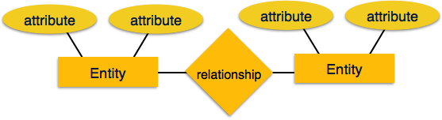
Entity-relationship model
Entity-Relationship (ER) Model is based on the notion of real-world entities and relationships among them. While formulating real-world scenario into the database model, the ER Model creates entity set, relationship set, general attributes and constraints.
ER Model is best used for the conceptual design of a database.
ER Model is based on −
1. Entities and their attributes.
2. Relationships among entities.

Slide 13
…
The ER(Entity Relationship) model defines the conceptual view of a database. It works around real-world entities and the associations among them.
Entity-
An entity can be a real-world object, either animate or inanimate, that can be easily identifiable. For example, in a school database, students, teachers, classes, and courses offered can be considered as entities.
Entities are represented by means of rectangles. Rectangles are named with the entity set they represent.

Slide 14
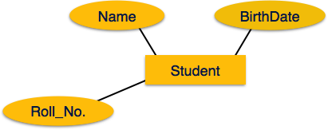
Attributes
Entities are represented by means of their properties, called attributes. All attributes have values. For example, a student entity may have name, class, and age as attributes.
Attributes are the properties of entities. Attributes are represented by means of ellipses. Every ellipse represents one attribute and is directly connected to its entity (rectangle).

Slide 15
Types of attribute
Simple attribute − Simple attributes are atomic values, which cannot be divided further. For example, a student's phone number is an atomic value of 10 digits.
Composite attribute − Composite attributes are made of more than one simple attribute. For example, a student's complete name may have first_name and last_name.
Derived attribute − Derived attributes are the attributes that do not exist in the physical database, but their values are derived from other attributes present in the database. For example, average_salary in a department should not be saved directly in the database, instead it can be derived. For another example, age can be derived from data_of_birth.
Single-value attribute − Single-value attributes contain single value. For example − Social_Security_Number.
Multi-value attribute − Multi-value attributes may contain more than one values. For example, a person can have more than one phone number, email_address, etc.

Slide 16
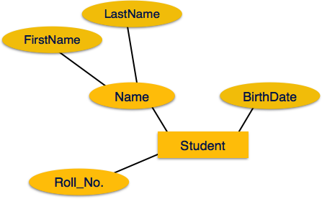
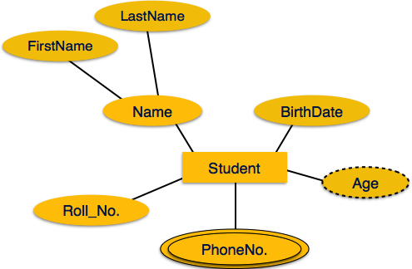
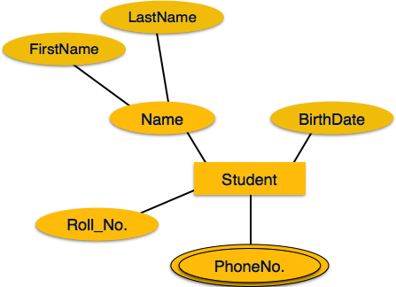
Composite Attribute
Simple Attribute
Multivalued Attribute
Derived Attribute

Slide 17
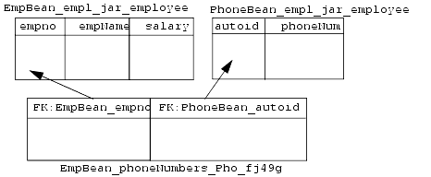
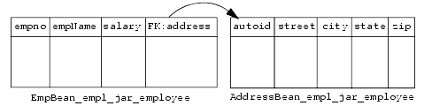
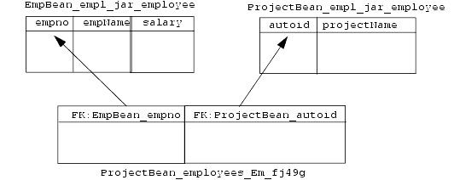
Mapping cardinalities −
One to Many
  One to One
Many to Many
Many to One
A person can have many addresses but if reverse this, then many addresses belongs to one person.
Means many entities belongs to one entity.

Slide 18
Relational model
The most popular data model in DBMS is the Relational Model. It is more scientific a model than others.
The main highlights of this model are −
Data is stored in tables called relations.
Relations can be normalized.
Each row in a relation contains a unique value.
Each column in a relation contains values from a same domain.

Slide 19
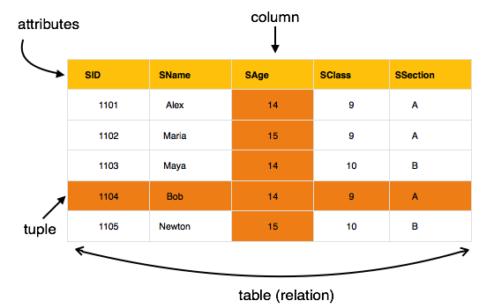

Slide 20
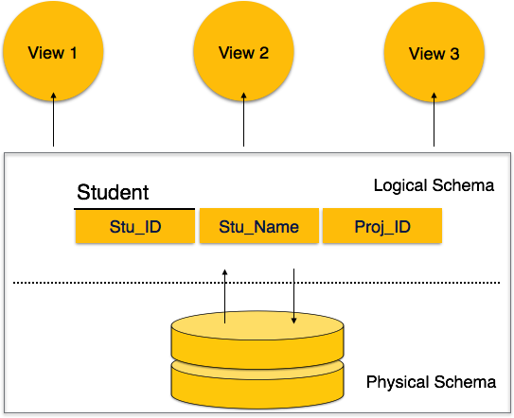
Database schema
A database schema is the skeleton structure that represents the logical view of the entire database. It defines how the data is organized and how the relations among them are associated.

Slide 21
…
A database schema can be divided broadly into two categories −
Physical Database Schema − This schema pertains to the actual storage of data and its form of storage like files, indices, etc. It defines how the data will be stored in a secondary storage.
Logical Database Schema − This schema defines all the logical constraints that need to be applied on the data stored. It defines tables, views, and integrity constraints.

Slide 22
Database instance
Database schema is the skeleton of database. It is designed when the database doesn't exist at all. Once the database is operational, it is very difficult to make any changes to it. A database schema does not contain any data or information.
A database instance is a state of operational database with data at any given time. It contains a snapshot of the database. Database instances tend to change with time. A DBMS ensures that its every instance (state) is in a valid state, by diligently following all the validations, constraints, and conditions that the database designers have imposed.

Slide 23
Sql Statement languages
1. Data Definition Language (DDL) statements are used to define the database structure or schema. Some examples:
  CREATE - to create objects in the database
  ALTER - alters the structure of the database
  DROP - delete objects from the database
  TRUNCATE - remove all records from a table, including all spaces allocated for the records are removed
  COMMENT - add comments to the data dictionary
  RENAME - rename an object

Slide 24
2. Data Manipulation Language (DML) statements are used for managing data within schema objects. Some examples:
  SELECT - retrieve data from the a database
  INSERT - insert data into a table
  UPDATE - updates existing data within a table
  DELETE - deletes all records from a table, the space for the records remain
  MERGE - UPSERT operation (insert or update)
  CALL - call a PL/SQL or Java subprogram
  EXPLAIN PLAN - explain access path to data
  LOCK TABLE - control concurrency

Slide 25
3. DCL: Data Control Language (DCL) statements. Some examples:
  GRANT - gives user's access privileges to database
  REVOKE - withdraw access privileges given with the GRANT command
4. Transaction Control (TCL) statements are used to manage the changes made by DML statements. It allows statements to be grouped together into logical transactions.
  COMMIT - save work done
  SAVEPOINT - identify a point in a transaction to which you can later roll back
  ROLLBACK - restore database to original since the last COMMIT
  SET TRANSACTION - Change transaction options like isolation level and what rollback segment to use

Slide 26
Entity-Set and Keys
Key is an attribute or collection of attributes that uniquely identifies an entity among entity set.
For example, the roll_number of a student makes him/her identifiable among students.
Super Key − A set of attributes (one or more) that collectively identifies an entity in an entity set. A superkey is a combination of columns that uniquely identifies any row within a relational database management system (RDBMS) table. A candidate key is a closely related concept where the superkey is reduced to the minimum number of columns required to uniquely identify each row.
Candidate Key − A candidate key is a column, or set of columns, in a table that can uniquely identify any database record without referring to any other data. Each table may have one or more candidate keys, but one candidate key is special, and it is called the primarykey. It is a minimal subset of super key.
Primary Key − A primary key is one of the candidate keys chosen by the database designer to uniquely identify the entity set. A primary key's main features are: It must contain a unique value for each row of data. It cannot contain null values.

Slide 27
Super Keys
Name+SSN+Birthdate
ID+Name+SSN
Table: Customer
Customer name
Customer ID
Social security number (SSN)
Address
Date of birth
Primary Key
SSN
ID
Candidate Keys
ID+SSN

Slide 28
Relationships
The association among entities is called a relationship. For example, an employee works_at a department, a student enrolls in a course. Here, Works_at and Enrolls are called relationships.
Relationship Sets
A set of relationships of similar type is called a relationship set. Like entities, a relationship too can have attributes. These attributes are called descriptive attributes.

Slide 29
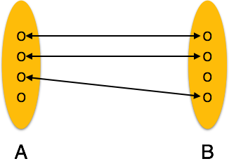
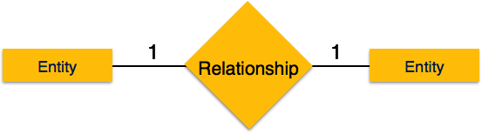
Mapping cardinalities
Cardinality defines the number of entities in one entity set, which can be associated with the number of entities of other set via relationship set.
One-to-one − One entity from entity set A can be associated with at most one entity of entity set B and vice versa. Like one student can have only one identity number or card

Slide 30
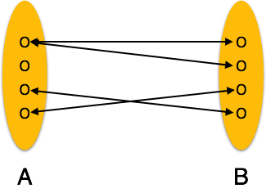
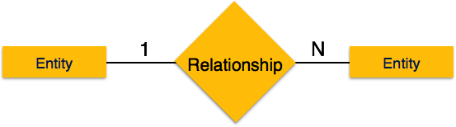
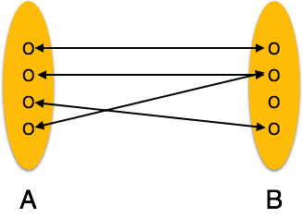
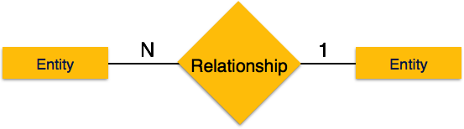
One-to-many −
One entity from entity set A can be associated with more than one entities of entity set B however an entity from entity set B, can be associated with at most one entity. Like one teacher can teach many students.
Many-to-one −
More than one entities from entity set A can be associated with at most one entity of entity set B, however an entity from entity set B can be associated with more than one entity from entity set A. Like Single course can be taken by many students.

Slide 31
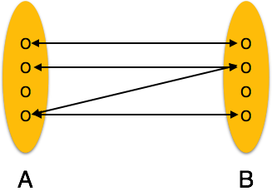

Many-to-many − One entity from A can be associated with more than one entity from B and vice versa. Like many students can work on single project and also a student can be associated with the many projects.

Slide 32
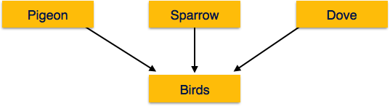
generalization
As mentioned above, the process of generalizing entities, where the generalized entities contain the properties of all the generalized entities, is called generalization. In generalization, a number of entities are brought together into one generalized entity based on their similar characteristics. For example, pigeon, house sparrow, crow and dove can all be generalized as Birds.

Slide 33
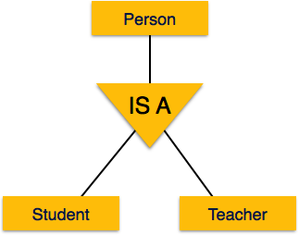
Specialization
Specialization is the opposite of generalization. In specialization, a group of entities is divided into sub-groups based on their characteristics.
Take a group ‘Person’ for example. A person has name, date of birth, gender, etc. These properties are common in all persons, human beings. But in a company, persons can be identified as employee, employer, customer, or vendor, based on what role they play in the company.

Slide 34
THANK YOU

