Slide 1
Database Design & Normalization
Unit-III

Slide 2
Determinant and Dependent
The expression X → Y means 'if I know the value of X, then I can obtain the value of Y' (in a table or somewhere).
In the expression X → Y, X is the determinant and Y is the dependent attribute.
  The value X determines the value of Y.
  The value Y depends on the value of X.

Slide 3
Functional Dependencies (FD)
An attribute is functionally dependent if its value is determined by another attribute which is a key.
That is, if we know the value of one (or several) data items, then we can find the value of another (or several).
Functional dependencies are expressed as X → Y, where X is the determinant and Y is the functionally dependent attribute.
If A →(B,C) then A → B and A → C.
If (A,B) → C, then it is not necessarily true that A → C and B → C.
If A → B and B → A, then A and B are in a 1-1 relationship.
If A → B then for A there can only ever be one value for B.

Slide 4
…
Functional dependency is a relationship that exists when one attribute uniquely determines another attribute.
If R is a relation with attributes X and Y, a functional dependency between the attributes is represented as X->Y, which specifies Y is functionally dependent on X. Here X is a determinant set and Y is a dependent attribute. Each value of X is associated precisely with one Y value.
Functional dependency in a database serves as a constraint between two sets of attributes. Defining functional dependency is an important part of relational database design and contributes to aspect normalization.
Example: In a table with attributes of employee name and Social Security number (SSN), employee name is functionally dependent on SSN because the SSN is unique for individual names. An SSN identifies the employee specifically, but an employee name cannot distinguish the SSN because more than one employee could have the same name.

Slide 5
…
SSN | Name
SSN->Name
Which means that name is functionally dependent on the SSN. Where SSN id determinant and Name is Dependent

Slide 6
Types of Functional Dependencies
Multivalued Functional Dependency
Transitive Functional Dependency
Trivial Functional Dependency
Non-Trivial Functional Dependency

Slide 7
Transitive Dependencies (TD)
An attribute is transitively dependent if its value is determined by another attribute which is not a key.
If X → Y and X is not a key then this is a transitive dependency.
A transitive dependency exists when
  A → B
  B → C
  but NOT A → C.

Slide 8
Company | CEO | Age
Microsoft | Satya Nadella | 51
Google | Sundar Pichai | 46
Alibaba | Jack Ma | 54
{Company} -> {CEO} (if we know the company, we know its CEO's name)
{CEO } -> {Age} If we know the CEO, we know the Age
Therefore, according to the rule of rule of transitive dependency:
{ Company} -> {Age} should hold, that makes sense because if we know the company name, we can know his age.
Note: You need to remember that transitive dependency can only occur in a relation of three or more attributes.

Slide 9
Author_ID | Author | Book | Author_Nationality
Auth_001 | Orson Scott Card | Ender's Game | United States
Auth_001 | Orson Scott Card | Ender's Game | United States
Auth_002 | Margaret Atwood | The Handmaid's Tale | Canada
Author_ID->Author | Author_Id can find an Author_Name uniquely
Author_ID->Nationality | Author_Id can find a Nationality uniquely
Author_ID -> Book X | Author_Id has no direct relation with Book. One Author can have many books. No unique record
Author -> Book X | Author_Id can have many Book (No unique result)
Book -> Author | From book name it is possible to find the author name (One book has One Author)- Unique results can be found

Slide 10
Author_ID | Author | Book | Author_Nationality
Auth_001 | Orson Scott Card | Ender's Game | United States
Auth_001 | Orson Scott Card | Ender's Game | United States
Auth_002 | Margaret Atwood | The Handmaid's Tale | Canada
Book_ID | Book | Author_ID
Book_001 | Ender's Game | Auth_001
Book_001 | Children of the Mind | Auth_001
Book_002 | The Handmaid's Tale | Auth_002
Author_ID | Author | Author_Nationality
Auth_001 | Orson Scott Card | United States
Auth_002 | Margaret Atwood | Canada

Slide 11
Multi-Valued Dependencies (MVD)
A table involves a multi-valued dependency if it may contain multiple values for an entity.
X→Y, i.e. X multi-determines Y, when for each value of X we can have more than one value of Y.
If A→B and A→C then we have a single attribute A which multi-determines two other independent attributes, B and C.
If A→(B,C) then we have an attribute A which multi-determines a set of associated attributes, B and C.

Slide 12
Multivalued dependency occurs in the situation where there are multiple independent multivalued attributes in a single table. A multivalued dependency is a complete constraint between two sets of attributes in a relation. It requires that certain tuples be present in a relation.
Car_model | Maf_year | Color
H001 | 2017 | Metallic
H001 | 2017 | Green
H005 | 2018 | Metallic
H010 | 2015 | Metallic
In this example, maf_year and color are independent of each other but dependent on car_model. In this example, these two columns are said to be multivalue dependent on car_model.
This dependence can be represented like this:
car_model -> maf_year
car_model-> colour

Slide 13
If you want the database to also track the sports these students take, you might think the easiest way to do this is to just add another column titled Sport:
If an attribute X uniquely determines an attribute Y, then Y is functionally dependent on X. This is written as ​X -> Y. For example, in the Students table below, the Student_Name determines the Major.
Student_Name | Major | Sport
Ravi | Art History | Soccer
Ravi | Art History | Volleyball
Ravi | Art History | Tennis
Beth | Chemistry | Tennis
Beth | Chemistry | Soccer
Student_Name | Major
Ravi | Art History
Beth | Chemistry
This table has introduced a multivalued dependency because the major and the sport are independent of one another but both depend on the student.

Slide 14
Trivial Functional Dependencies
Trivial Functional dependency:
The Trivial dependency is a set of attributes which are called a trivial if the set of attributes are included in that attribute.
So, X -> Y is a trivial functional dependency if Y is a subset of X.
Consider this table with two columns Emp_id and Emp_name.
{Emp_id, Emp_name} -> Emp_id is a trivial functional dependency as Emp_id is a subset of {Emp_id,Emp_name}.
Emp_id | Emp_name
AS555 | Harry
AS811 | George
AS999 | Kevin

Slide 15
Non-Trivial Dependency
Functional dependency which also known as a nontrivial dependency occurs when A->B holds true where B is not a subset of A. In a relationship, if attribute B is not a subset of attribute A, then it is considered as a non-trivial dependency.
Company | CEO | Age
Microsoft | Satya Nadella | 51
Google | Sundar Pichai | 46
Apple | Tim Cook | 57
Example:
(Company} -> {CEO} (if we know the Company, we knows the CEO name)
But CEO is not a subset of Company, and hence it's non-trivial functional dependency.

Slide 16
NORMALIZATION

Slide 17
Why Normalization: Redundancy
Roll No. | Name | Age | Branch | Branch ID
1 | Anmol | 24 | CSE | 101
2 | Ansh | 23 | CSE | 101
3 | Akshay | 25 | CSE | 101
4 | Bhuvnesh | 26 | CSE | 102

Slide 18
Anomalies of Database
Update Anomalies
Deletion Anomalies
Insert Anomalies

Slide 19
Update anomalies
If data items are scattered and are not linked to each other properly, then it could lead to strange situations. For example, when we try to update one data item having its copies scattered over several places, a few instances get updated properly while a few others are left with old values. Such instances leave the database in an inconsistent state.
In the above example if the branch code 101 is updated to 102, in that case we need to update all the rows.

Slide 20
Deletion anomalies
We tried to delete a record, but parts of it was left undeleted because of unawareness, the data is also saved somewhere else.
In the above slide example, when we delete all the record of students automatically the data of branch name and branch id is getting deleted, which is not required to delete. We are deleting student information because of which branch information is also being deleted.

Slide 21
Insert anomalies
An Insert Anomaly occurs when certain attributes cannot be inserted into the database without the presence of other attributes. For example this is the converse of delete anomaly - we can't add a new course unless we have at least one student enrolled on the course.

Slide 22
Normalization
Normalization is a method to remove all these anomalies and bring the database to a consistent state or we can say it is the process to remove redundancy.
It contains 4 ways to resolve anomalies using 4 normal forms.
First Normal Form
Second Normal Form
Third Normal Form
Boyce-Codd Normal Form

Slide 23
Why Normalization
Roll No. | Name | Age | Branch Name | Branch ID | HOD
Roll No. | Name | Age | Branch ID
Branch Id | Branch Name | HOD

Slide 24
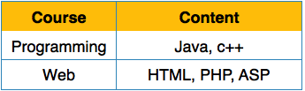
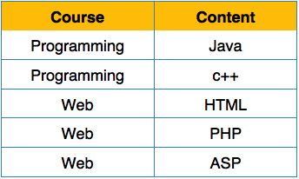
First Normal Form
First Normal Form is defined in the definition of relations (tables) itself. This rule defines that all the attributes in a relation must have atomic domains. The values in an atomic domain are indivisible units.
Before Normalization
We re-arrange the relation (table), to convert it to First Normal Form.
After Normalization

Slide 25
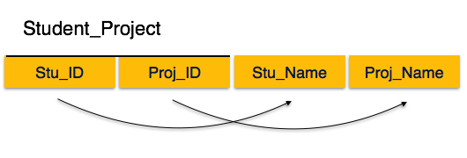
Second Normal Form
A relation is in second normal form if it is in 1NF and every non key attribute is fully functionally dependent on the primary key.
Prime Key Attributes: Stud_ID, Proj_ID
Non Key Attributes: Stu_Name, Proj_Name
As per rule: Non-key attributes, i.e. Stu_Name and Proj_Name must be dependent upon both and not on any of the prime key attribute individually.
But we find that Stu_Name can be identified by Stu_ID and Proj_Name can be identified by Proj_ID independently. This is called partial dependency, which is not allowed in Second Normal Form.

Slide 26
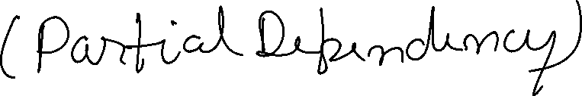
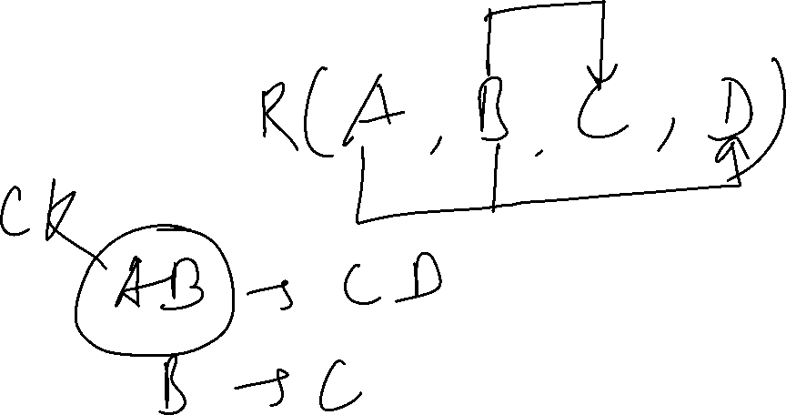
…

Slide 27
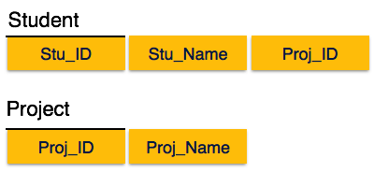
…

Slide 28
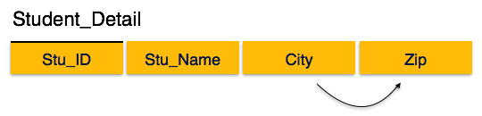
Third Normal Form
For a relation to be in Third Normal Form, and the following must satisfy −
It must be in Second Normal form
No non key attribute is transitively dependent on the primary key.
We find that in the above Student_detail relation, Stu_ID is the key and only prime key attribute. We find that City can be identified by Stu_ID as well as Zip itself. Neither Zip is a superkey nor is City a prime attribute. Additionally, Stu_ID → Zip → City, so there exists transitive dependency.

Slide 29
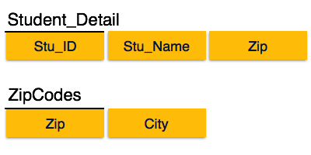
…

Slide 30

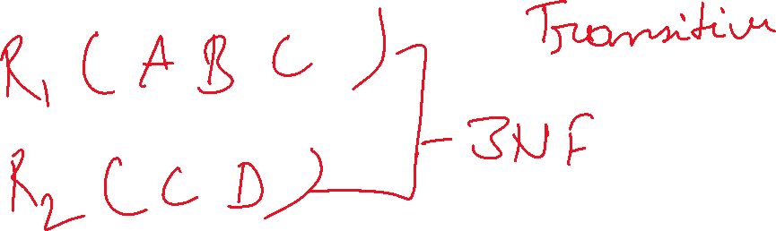

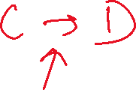



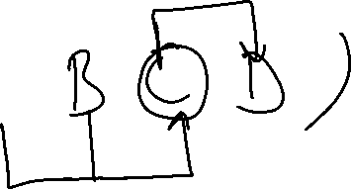
…

Slide 31
Boyce-Codd Normal Form
Boyce-Codd Normal Form (BCNF) is an extension of Third Normal Form on strict terms. BCNF states that −
For any non-trivial functional dependency, X → A, X must be a super-key.
In the above image, Stu_ID is the super-key in the relation Student_Detail and Zip is the super-key to the relation ZipCodes. So,
Stu_ID → Stu_Name, Zip
and
Zip → City
Which confirms that both the relations are in BCNF.

Slide 32
Column Name | Data Type
supplierID(primary key) | Int
suppliername | varchar(20)
products | varchar(20)
Suppliers
SupplierID | Supplier Name | Products
1 | Yeki Inc. | tshirt, shirt, jeans
1NF
First Normal
Form
Column Name | Data Type
supplierID(primary key) | Int
suppliername | varchar(20)
Suppliers
Column Name | Data Type
Productid | Int
Productname | varchar(20)
Supplierid | Int
Products

Slide 33
Column Name | Data Type
Productid | Int
Productname | varchar(20)
StoreName | Varchar(20)
Price | int
ProductID | ProductName | StoreName | Price
1 | Blue Shirt | Store1 | 2000
2 | White Shirt | Store2 | 2300
3 | Grey Shirt | Store5 | 2200
4 | Blue Shirt | Store4 | 2000
Products
Products
Stores
Column Name | Data Type
Productid | Int
Productname | varchar(20)
Price | int
Column Name | Data Type
Storeid | Int
StoreName | varchar(20)
ProductName | Varchar(20)
There should not be any partial key dependencies. Attribute must be depended upon key.
Another principle is there should not be no derived data or calculated fields, such as total, while you have price and quantity in the table.
Here product is dependent on store but the attributes don’t have to be depend only on key, so product name in this case does depend on store, but it doesn’t only depend on store for its existence.
2NF
Second Normal
Form

Slide 34
Products
Stores
Column Name | Data Type
Productid | Int
Productname | varchar(20)
Price | int
Column Name | Data Type
Storeid | Int
StoreName | varchar(20)
Inventory
3NF
Third Normal
Form
Column Name | Data Type
Storeid | Int
Productid | varchar(20)
Attribute must be solely dependent upon the key.
Third normal form essentially removes the transitive dependency.

Slide 35
BCNF
StudentID | Name | Course | Duration
1 | Tom | Java | 60
2 | Jerry | Database | 90
3 | Duck | Database Adv | 100
4 | Donalds | Database | 100

Slide 36
Loss-less join Decomposition
Decomposition – the process of breaking down in parts or elements.
Decomposition in database means breaking tables down into multiple tables From Database perspective means going to a higher normal form.
Important that decompositions are “good”,
Two Characteristics of Good Decompositions
1) Lossless: Means functioning without a loss. In other words, retain everything after being break in two or more tables.
2) Preserve dependencies

Slide 37
Lossless Decomposition
Sometimes the same set of data is reproduced:
(Word, 100) + (Word, WP) → (Word, 100, WP)
(Oracle, 1000) + (Oracle, DB) → (Oracle, 1000, DB)
(Access, 100) + (Access, DB) → (Access, 100, DB)
Name | Price | Category
Word | 100 | WP
Oracle | 1000 | DB
Access | 100 | DB
Name | Price
Word | 100
Oracle | 1000
Access | 100
Name | Category
Word | WP
Oracle | DB
Access | DB

Slide 38
Lossy Decomposition
Sometimes it’s not:
(Word, WP) + (100, WP) = (Word, 100, WP)
(Oracle, DB) + (1000, DB) = (Oracle, 1000, DB)
(Oracle, DB) + (100, DB) = (Oracle, 100, DB)
(Access, DB) + (1000, DB) = (Access, 1000, DB)
(Access, DB) + (100, DB) = (Access, 100, DB)
What’s
wrong?
Name | Price | Category
Word | 100 | WP
Oracle | 1000 | DB
Access | 100 | DB
Category | Name
WP | Word
DB | Oracle
DB | Access
Category | Price
WP | 100
DB | 1000
DB | 100

Slide 39
THANKS

