Slide 1
Transaction Processing Concept
Unit iV
Nishant kumar

Slide 2
Transaction
A transaction can be defined as a group of tasks. A single task is the minimum processing unit which cannot be divided further.
Let’s take an example of a simple transaction. Suppose a bank employee transfers Rs 500 from A's account to B's account. This very simple and small transaction involves several low-level tasks.
Open_Account(A)
Old_Balance = A.balance
New_Balance = Old_Balance - 500
A.balance = New_Balance
Close_Account(A)
Open_Account(B)
Old_Balance = B.balance
New_Balance = Old_Balance + 500
B.balance = New_Balance
Close_Account(B)

Slide 3
ACID Properties
A transaction is a very small unit of a program and it may contain several low level tasks. A transaction in a database system must maintain Atomicity, Consistency, Isolation, and Durability − commonly known as ACID properties − in order to ensure accuracy, completeness, and data integrity.
Atomicity:
  This property states that a transaction must be treated as an atomic unit, that is, either all of its operations are executed or none. There must be no state in a database where a transaction is left partially completed. States should be defined either before the execution of the transaction or after the execution/abortion/failure of the transaction.
Consistency:
  The database must remain in a consistent state after any transaction. No transaction should have any adverse effect on the data residing in the database. If the database was in a consistent state before the execution of a transaction, it must remain consistent after the execution of the transaction as well.

Slide 4
…
Durability:
  The database should be durable enough to hold all its latest updates even if the system fails or restarts. If a transaction updates a chunk of data in a database and commits, then the database will hold the modified data. If a transaction commits but the system fails before the data could be written on to the disk, then that data will be updated once the system springs back into action.
Isolation:
  In a database system where more than one transaction are being executed simultaneously and in parallel, the property of isolation states that all the transactions will be carried out and executed as if it is the only transaction in the system. No transaction will affect the existence of any other transaction.

Slide 5
Serializability
When multiple transactions are being executed by the operating system in a multiprogramming environment, there are possibilities that instructions of one transactions are interleaved with some other transaction.
Schedule:
  A chronological execution sequence of a transaction is called a schedule. A schedule can have many transactions in it, each comprising of a number of instructions/tasks.
Serial Schedule:
  It is a schedule in which transactions are aligned in such a way that one transaction is executed first. When the first transaction completes its cycle, then the next transaction is executed. Transactions are ordered one after the other. This type of schedule is called a serial schedule, as transactions are executed in a serial manner.

Slide 6
…
In a multi-transaction environment, serial schedules are considered as a benchmark.
The execution sequence of an instruction in a transaction cannot be changed, but two transactions can have their instructions executed in a random fashion. This execution does no harm if two transactions are mutually independent and working on different segments of data; but in case these two transactions are working on the same data, then the results may vary. This ever-varying result may bring the database to an inconsistent state.
To resolve this problem, we allow parallel execution of a transaction schedule, if its transactions are either serializable or have some equivalence relation among them.

Slide 7
Equivalence Schedules
An equivalence schedule can be of the following types −
1. Result Equivalence
  If the two transactions generate same result after their execution then it is called as result equivalence. For example, one transaction is updating the marks of Student X and the other transaction is to insert a new student. Here both the transactions are totally independent and their order of execution does not matter. Whichever order they are executed; the result is the same. Hence it is called result equivalence transactions.
2. View Equivalence
3. Conflict Equivalence

Slide 8
View Equivalence
Two schedules are said to be view equivalence, if the transaction in one schedule is same as the one in other. That means, both the transactions in two schedules perform same tasks.
For example, say schedule1 has transaction to insert new students into STUDENT table and second schedule has the transaction to maintain the old student records in a new table called OLD_STUDENT. In both the schedules student details are inserted, but different tables (it does not matter if it is same table). Such schedules are called as view equivalence schedule.
For example −
  If T reads the initial data in S1, then it also reads the initial data in S2.
  If T reads the value written by J in S1, then it also reads the value written by J in S2.
  If T performs the final write on the data value in S1, then it also performs the final write on the data value in S2.

Slide 9
Conflict Equivalence
Two schedules would be conflicting if they have the following properties −
  Both belong to separate transactions.
  Both accesses the same data item.
  At least one of them is "write" operation.
In this case both schedules will have different set of transactions, but they would be accessing same data and one of the schedules will be inserting/updating the records. In this equivalence, both the schedules will have conflicting set of transactions. Above example of updating the marks of one student by one transaction and calculating the total marks at the same time is a conflicting equivalence.
In all these cases if the transaction is serialized, then the issues can be resolved.

Slide 10
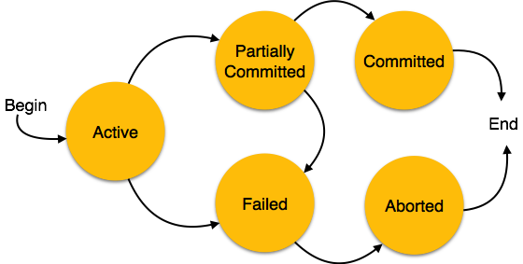
States of Transaction
Active
Partially Committed − When a transaction executes its final operation, it is said to be in a partially committed state.
Failed − A transaction is said to be in a failed state if any of the checks made by the database recovery system fails. A failed transaction can no longer proceed further.
Aborted − If any of the checks fails and the transaction has reached a failed state, then the recovery manager rolls back all its write operations on the database to bring the database back to its original state where it was prior to the execution of the transaction. Transactions in this state are called aborted. The database recovery module can select one of the two operations after a transaction aborts −
  Re-start the transaction
  Kill the transaction
Committed

Slide 11
Recovery and Atomicity
When the system recovers from a failure, it can restore the latest dump.
When a system crashes, it may have several transactions being executed and various files opened for them to modify the data items.
Transactions are made of various operations, which are atomic in nature. But according to ACID properties of DBMS, atomicity of transactions as a whole must be maintained, that is, either all the operations are executed or none.
When a DBMS recovers from a crash, it should maintain the following −
  It should check the states of all the transactions, which were being executed.
  A transaction may be in the middle of some operation; the DBMS must ensure the atomicity of the transaction in this case.
  It should check whether the transaction can be completed now or it needs to be rolled back.
  No transactions would be allowed to leave the DBMS in an inconsistent state.

Slide 12
…
There are two types of techniques, which can help a DBMS in recovering as well as maintaining the atomicity of a transaction −
Maintaining the logs of each transaction, and writing them onto some stable storage before actually modifying the database.
Maintaining shadow paging, where the changes are done on a volatile memory, and later, the actual database is updated

Slide 13
Log-based Recovery
Log is a sequence of records, which maintains the records of actions performed by a transaction. It is important that the logs are written prior to the actual modification and stored on a stable storage media, which is failsafe.
The update log record describes a single database write:
1. Transaction Identifier 2. Data-item identifier 3. Old Value 4. New Value
Log-based recovery works as follows −
  The log file is kept on a stable storage media.
  <Tn, Start>: When a transaction enters the system and starts execution, it writes a log about it
  <Tn, X, V1, V2>: When the transaction modifies an item X, it write logs, It reads Tn has changed the value of X, from V1 to V2.
  <Tn, commit>: When the transaction finishes.

Slide 14
…
Database can be modified using two approaches:
Deferred database modification −
The deferred-modification technique ensures transaction atomicity by recording all database modifications in the log, but deferring all write operations of a transaction until the transaction partially commits (i.e., once the final action of the transaction has been executed). Then the information in the logs is used to execute the deferred writes. If the system crashes or if the transaction aborts, then the information in the logs is ignored.
Immediate database modification −
The immediate-update technique allows database modifications to be output to the database while the transaction is still in the active state. These modifications are called uncommitted modifications. In the event of a crash or transaction failure, the system must use the old-value field of the log records to restore the modified data items.

Slide 15
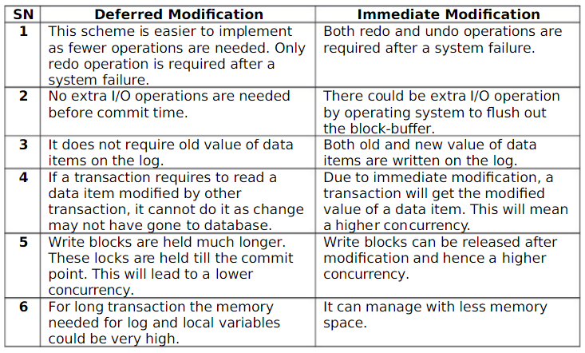

Slide 16
Recovery with Concurrent Transactions
When more than one transaction are being executed in parallel, the logs are interleaved. At the time of recovery, it would become hard for the recovery system to backtrack all logs, and then start recovering. To ease this situation, most modern DBMS use the concept of 'checkpoints'.
Checkpoint
Checkpoint is a mechanism where all the previous logs are removed from the system and stored permanently in a storage disk.
Checkpoint declares a point before which the DBMS was in consistent state, and all the transactions were committed.

Slide 17
Transaction Recovery
When a system with concurrent transactions crashes and recovers, it behaves in the following manner −
The recovery system reads the logs backwards from the end to the last checkpoint.
It maintains two lists, an undo-list and a redo-list.
  If the recovery system sees a log with <Tn, Start> and <Tn, Commit> or just <Tn, Commit>, it puts the transaction in the redo-list.
  If the recovery system sees a log with <Tn, Start> but no commit or abort log found, it puts the transaction in undo-list.
All the transactions in the undo-list are then undone and their logs are removed. All the transactions in the redo-list and their previous logs are removed and then redone before saving their logs.

Slide 18
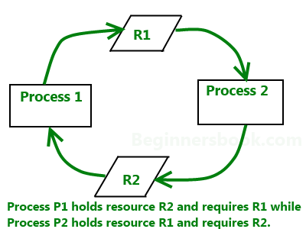
Deadlock
A deadlock is a condition wherein two or more tasks are waiting for each other in order to be finished but none of the task is willing to give up the resources that other task needs. In this situation no task ever gets finished and is in waiting state forever.
Deadlocks are not healthy for a system. In case a system is stuck in a deadlock, the transactions involved in the deadlock are either rolled back or restarted.

Slide 19
Deadlock Prevention
To prevent any deadlock situation in the system, the DBMS aggressively inspects all the operations, where transactions are about to execute. The DBMS inspects the operations and analyzes if they can create a deadlock situation. If it finds that a deadlock situation might occur, then that transaction is never allowed to be executed.
There are deadlock prevention schemes that use timestamp ordering mechanism of transactions in order to predetermine a deadlock situation.
Wait Die Scheme
Wound Wait Scheme

Slide 20
Wait-Die Scheme
This Deadlock prevention scheme as indicated by its name halts a transaction and terminates any further transactions occurring after such that there is no deadlock.
Rules:
If a transaction is requesting a lock on the resource and is found to be of an older time stamp than the transaction which has the resource locked, it is not terminated.
If a transaction is requesting a lock on the resource and is found to be of a younger time stamp than the transaction which has the resource locked, it is terminated.

Slide 21
…
(1) If TS(Ti) < TS(Tj) − that is Ti, which is requesting a conflicting lock, is older than Tj − then Ti is allowed to wait until the data-item is available.
(2) If TS(Ti) > TS(tj) − that is Ti is younger than Tj − then Ti dies. Ti is restarted later with a random delay but with the same timestamp.
For example:
Suppose that transaction T22, T23, T24 have time-stamps 5, 10 and 15 respectively. If T22requests a data item held by T23 then T22 will wait. If T24 requests a data item held by T23, then T24 will be rolled back.

Slide 22
Wound-Wait Scheme
This Deadlock prevention scheme as indicated by its name halts any further transaction that requests the resource.
If an older timestamp transaction is requesting a lock on the resource, it is not terminated and made to wait for the resource to be available.
If a transaction is requesting a lock on the resource and is found to be of an older time stamp than the transaction which is in line for the resource, it can terminate the younger transaction and take over the resource. The time stamp with a younger time stamp is then rebooted.
The one thing that’s common in both the deadlock prevention schemes is that the transaction that enters the system late and has a younger time stamp is aborted.

Slide 23
…
(1) If TS(Ti) < TS(Tj), then Ti forces Tj to be rolled back − that is Ti wounds Tj. Tj is restarted later with a random delay but with the same timestamp.
(2) If TS(Ti) > TS(Tj), then Ti is forced to wait until the resource is available.
For example:
Suppose that Transactions T22, T23, T24 have time-stamps 5, 10 and 15 respectively . If T22requests a data item held by T23, then data item will be pre-empted from T23 and T23 will be rolled back. If T24 requests a data item held by T23, then T24 will wait.

Slide 24
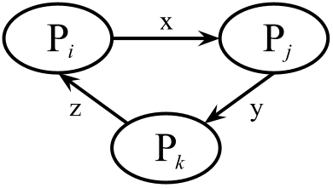
Deadlock Avoidance
Deadlock avoidance mechanisms can be used to detect any deadlock situation in advance. Methods like "wait-for graph" are available but they are suitable for only those systems where transactions are lightweight having fewer instances of resource.
Wait-for Graph
This is a simple method available to track if any deadlock situation may arise. For each transaction entering into the system, a node is created. When a transaction Ti requests for a lock on an item, say X, which is held by some other transaction Tj, a directed edge is created from Ti to Tj. If Tj releases item X, the edge between them is dropped and Ti locks the data item.
The system maintains this wait-for graph for every transaction waiting for some data items held by others. The system keeps checking if there's any cycle in the graph.

Slide 25
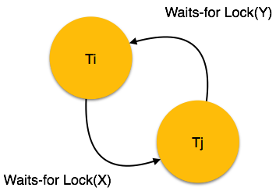
…
Here, we can use any of the two following approaches −
First, do not allow any request for an item, which is already locked by another transaction. This is not always feasible and may cause starvation, where a transaction indefinitely waits for a data item and can never acquire it.
The second option is to roll back one of the transactions. It is not always feasible to roll back the younger transaction, as it may be important than the older one. With the help of some relative algorithm, a transaction is chosen, which is to be aborted. This transaction is known as the victim and the process is known as victim selection.

Slide 26
THANKS

