Slide 1
Concurrency Control Techniques
Unit-V

Slide 2
Concurrency Control
In a multiprogramming environment where multiple transactions can be executed simultaneously, it is highly important to control the concurrency of transactions. We have concurrency control protocols to ensure atomicity, isolation, and serializability of concurrent transactions. Concurrency control protocols can be broadly divided into two categories −
Lock based protocols
Time stamp based protocols

Slide 3
Lock-based Protocols
Database systems equipped with lock-based protocols use a mechanism by which any transaction cannot read or write data until it acquires an appropriate lock on it. Locks are of two kinds –
Binary Locks − A lock on a data item can be in two states; it is either locked or unlocked.
Shared/exclusive − This type of locking mechanism differentiates the locks based on their uses. If a lock is acquired on a data item to perform a write operation, it is an exclusive lock. Allowing more than one transaction to write on the same data item would lead the database into an inconsistent state. Read locks are shared because no data value is being changed.

Slide 4
Lock Protocols
There are four types of lock of protocol-
Simplistic Lock Protocol
Pre-claiming Lock Protocol
Two-Phase Locking 2PL
Strict Two Phase Locking

Slide 5
Simplistic Lock Protocol
Simplistic lock-based protocols allow transactions to obtain a lock on every object before a 'write' operation is performed. Transactions may unlock the data item after completing the ‘write’ operation.

Slide 6
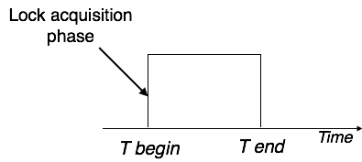
Pre-claiming Lock Protocol
Pre-claiming protocols evaluate their operations and create a list of data items on which they need locks.
Before initiating an execution, the transaction requests the system for all the locks it needs beforehand.
If all the locks are granted, the transaction executes and releases all the locks when all its operations are over.
If all the locks are not granted, the transaction rolls back and waits until all the locks are granted.

Slide 7
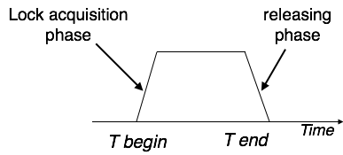
Two-phase Locking 2PL
This locking protocol divides the execution phase of a transaction into three parts.
In the first part, when the transaction starts executing, it seeks permission for the locks it requires.
The second part is where the transaction acquires all the locks. As soon as the transaction releases its first lock, the third phase starts.
In third part, the transaction cannot demand any new locks; it only releases the acquired locks.
Two-phase locking has two phases, one is growing, where all the locks are being acquired by the transaction; and the second phase is shrinking, where the locks held by the transaction are being released.
To claim an exclusive (write) lock, a transaction must first acquire a shared (read) lock and then upgrade it to an exclusive lock.

Slide 8
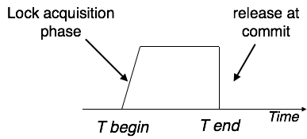
Strict Two-Phase Locking
The first phase of Strict-2PL is same as 2PL. After acquiring all the locks in the first phase, the transaction continues to execute normally.
In contrast to 2PL, Strict-2PL does not release a lock after using it.
Strict-2PL holds all the locks until the commit point and releases all the locks at a time.

Slide 9
Timestamp based Protocols
Lock-based protocols manage the order between the conflicting pairs among transactions at the time of execution, whereas timestamp-based protocols start working as soon as a transaction is created.
Every transaction has a timestamp associated with it, and the ordering is determined by the age of the transaction.
A transaction created at 0002 clock time would be older than all other transactions that come after it. For example, any transaction 'y' entering the system at 0004 is two seconds younger and the priority would be given to the older one.
In addition, every data item is given the latest read and write-timestamp. This lets the system know when the last ‘read and write’ operation was performed on the data item.

Slide 10
Timestamp Ordering Protocol
The timestamp-ordering protocol ensures serializability among transactions in their conflicting read and write operations. This is the responsibility of the protocol system that the conflicting pair of tasks should be executed according to the timestamp values of the transactions.
The timestamp of transaction Ti is denoted as TS(Ti).
Read time-stamp of data-item X is denoted by R-timestamp(X).
Write time-stamp of data-item X is denoted by W-timestamp(X)

Slide 11
Timestamp ordering protocol works as follows −
If a transaction Ti issues a read(X) operation −
  If TS(Ti) < W-timestamp(X)
    Operation rejected. (TS(Ti) is a younger transaction)
  If TS(Ti) >= W-timestamp(X)
    Operation executed. (TS(Ti) is an older transaction)
  All data-item timestamps updated.
If a transaction Ti issues a write(X) operation −
  If TS(Ti) < R-timestamp(X)
    Operation rejected.
  If TS(Ti) < W-timestamp(X)
    Operation rejected and Ti rolled back. (Thomas Write Rule)
  Otherwise, operation executed.

Slide 12
Multiple Granularity
Multiple Granularity is the hierarchically breaking up the database into portions which are lockable and maintaining the track of what to be lock and how much to be lock so that it can be decided very quickly either to lock a data item or to unlock a data item.

Slide 13
Recovery with Concurrent Transaction
Checkpoint
Keeping and maintaining logs in real time and in real environment may fill out all the memory space available in the system. As time passes, the log file may grow too big to be handled at all. Checkpoint is a mechanism where all the previous logs are removed from the system and stored permanently in a storage disk. Checkpoint declares a point before which the DBMS was in consistent state, and all the transactions were committed.
Recovery
When a system with concurrent transactions crashes and recovers, it behaves in the following manner −

Slide 14
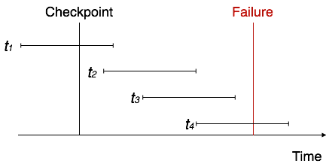
The recovery system reads the logs backwards from the end to the last checkpoint.
It maintains two lists, an undo-list and a redo-list.
If the recovery system sees a log with <Tn, Start> and <Tn, Commit> or just <Tn, Commit>, it puts the transaction in the redo-list.
If the recovery system sees a log with <Tn, Start> but no commit or abort log found, it puts the transaction in undo-list.

Slide 15
Transaction Processing in Distributed Systems
A transaction is a logical unit of work constituted by one or more SQL statements executed by a single user. A transaction begins with the user's first executable SQL statement and ends when it is committed or rolled back by that user.
A remote transaction contains only statements that access a single remote node. A distributed transaction contains statements that access more than one node.
SELECT * FROM scott.dept@sales.us.americas.acme_auto.com;
Remote Select SQL Statement
UPDATE scott.dept@mktng.us.americas.acme_auto.com SET loc = 'NEW YORK' WHERE deptno = 10;
Remote Update SQL Statement

Slide 16
Distributed SQL Statement
SELECT ename, dname FROM scott.emp e, scott.dept@sales.us.americas.acme_auto.com d WHERE e.deptno = d.deptno;
A distributed update statement modifies data on two or more nodes.
A distributed update is possible using a PL/SQL subprogram unit such as a procedure or trigger that includes two or more remote updates that access data on different nodes.
For example, the following PL/SQL program unit updates tables on the local database and the remote sales database:
BEGIN
UPDATE scott.dept@sales.us.americas.acme_auto.com
SET loc = 'NEW YORK'
WHERE deptno = 10;
UPDATE scott.emp
SET deptno = 11
WHERE deptno = 10;
END;
COMMIT;

Slide 17
Data Replication and Allocation
Replication is useful in in improving the availability of data.
This can improve availability remarkably because the system can continue to operate as long as at least one site is up. It also improves performance of retrieval for global queries, because the result of such a query can be obtained locally from any one site.
The disadvantage of full Replication is that it can slow down update operations drastically, since a single logical update must be performed on every copy of the database to keep the copies consistent.

Slide 18
THANKS

