Slide 1

Database Design & Normalization

Slide 2
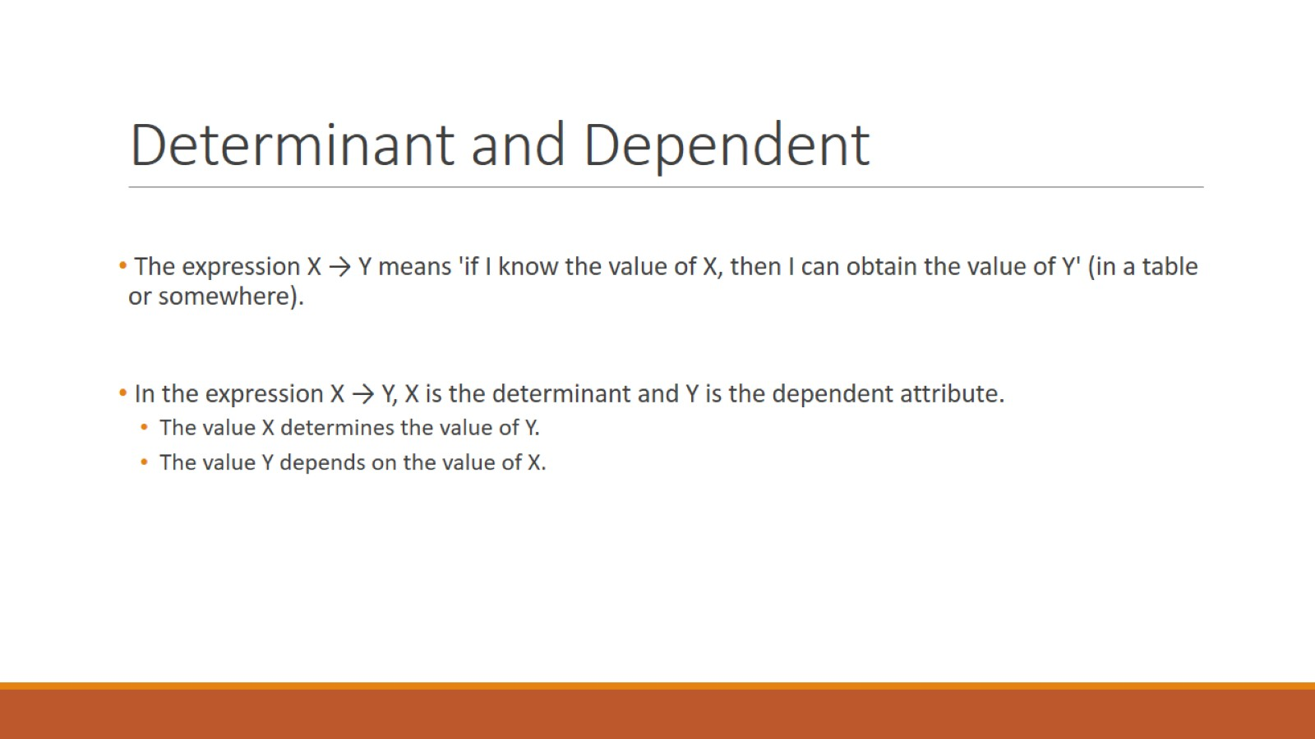
Determinant and Dependent

Slide 3
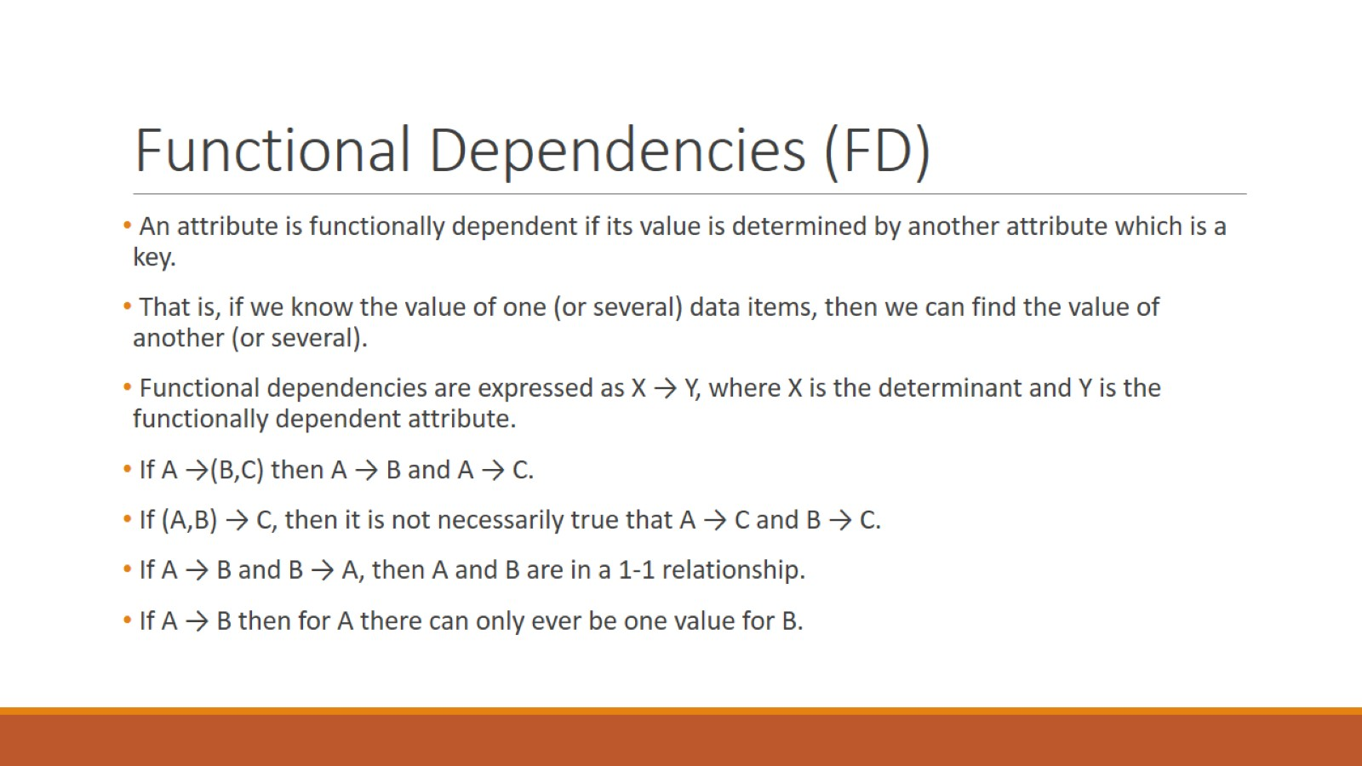
Functional Dependencies (FD)

Slide 4
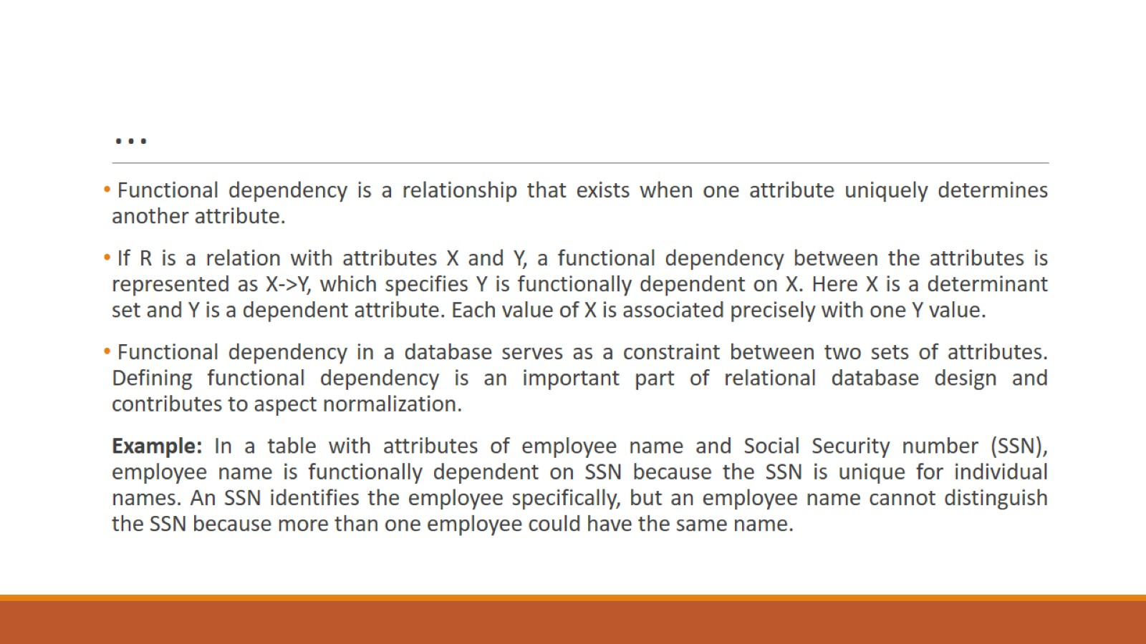
…

Slide 5
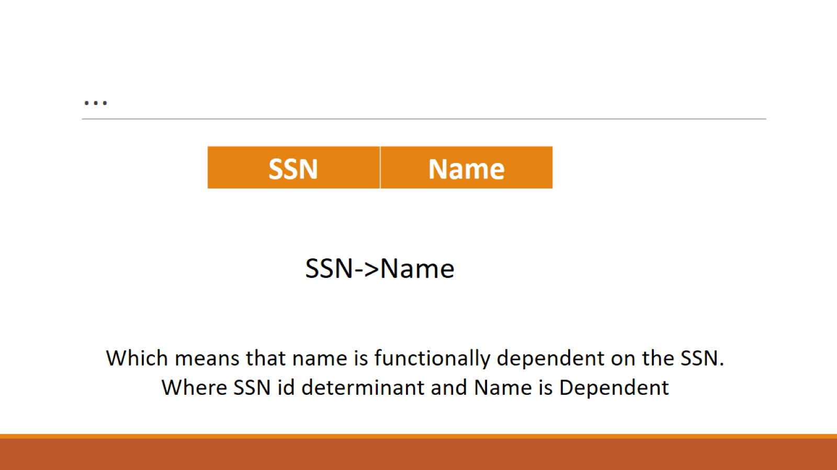
…

Slide 6
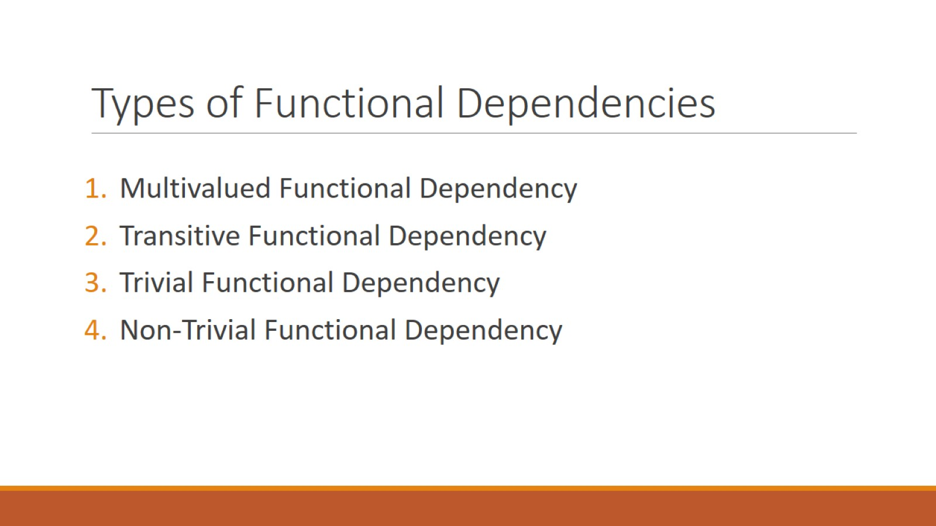
Types of Functional Dependencies

Slide 7
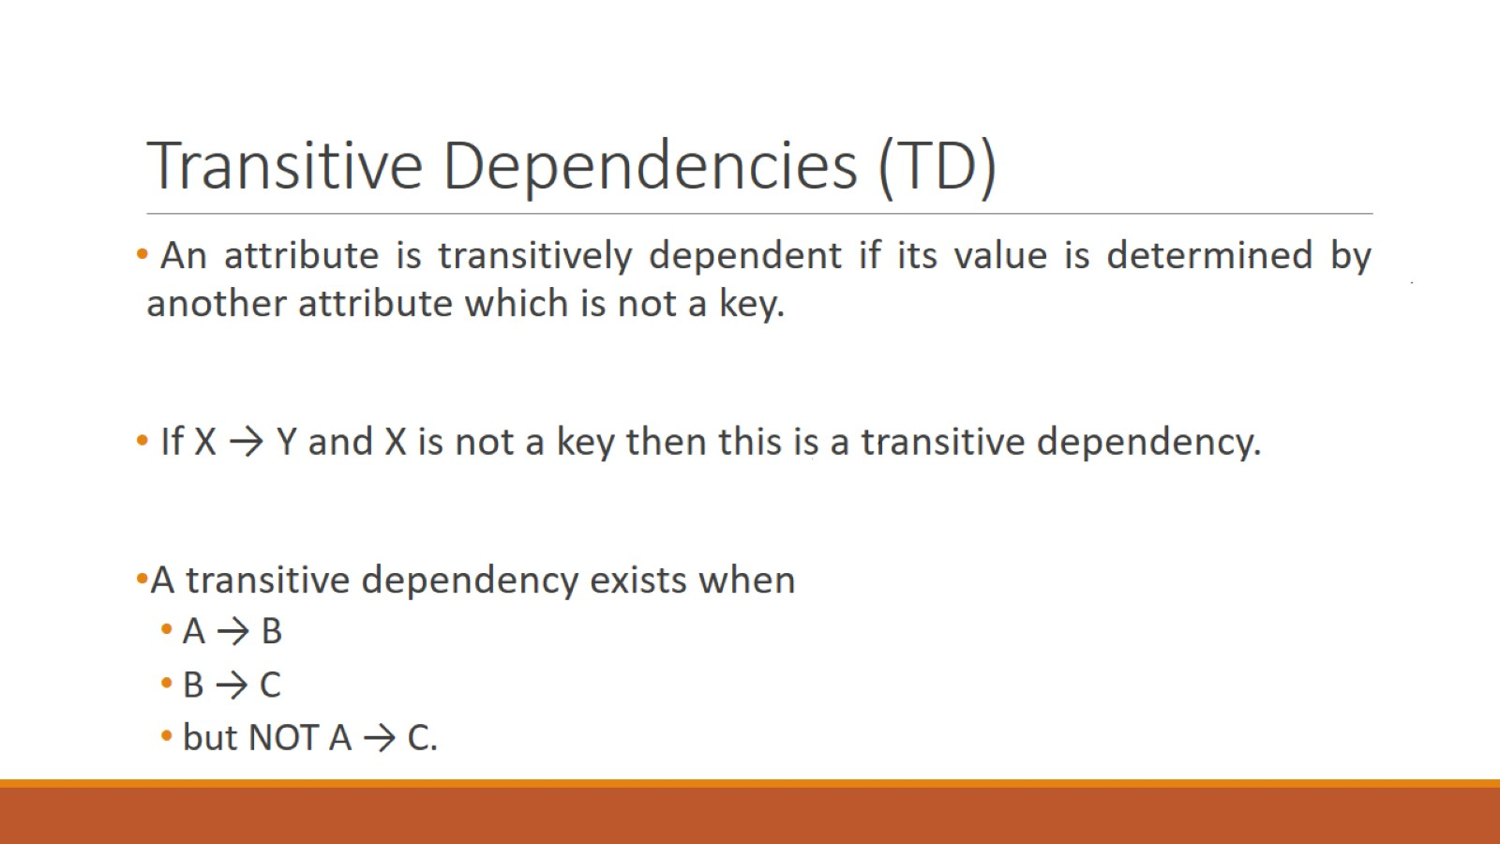
Transitive Dependencies (TD)

Slide 8
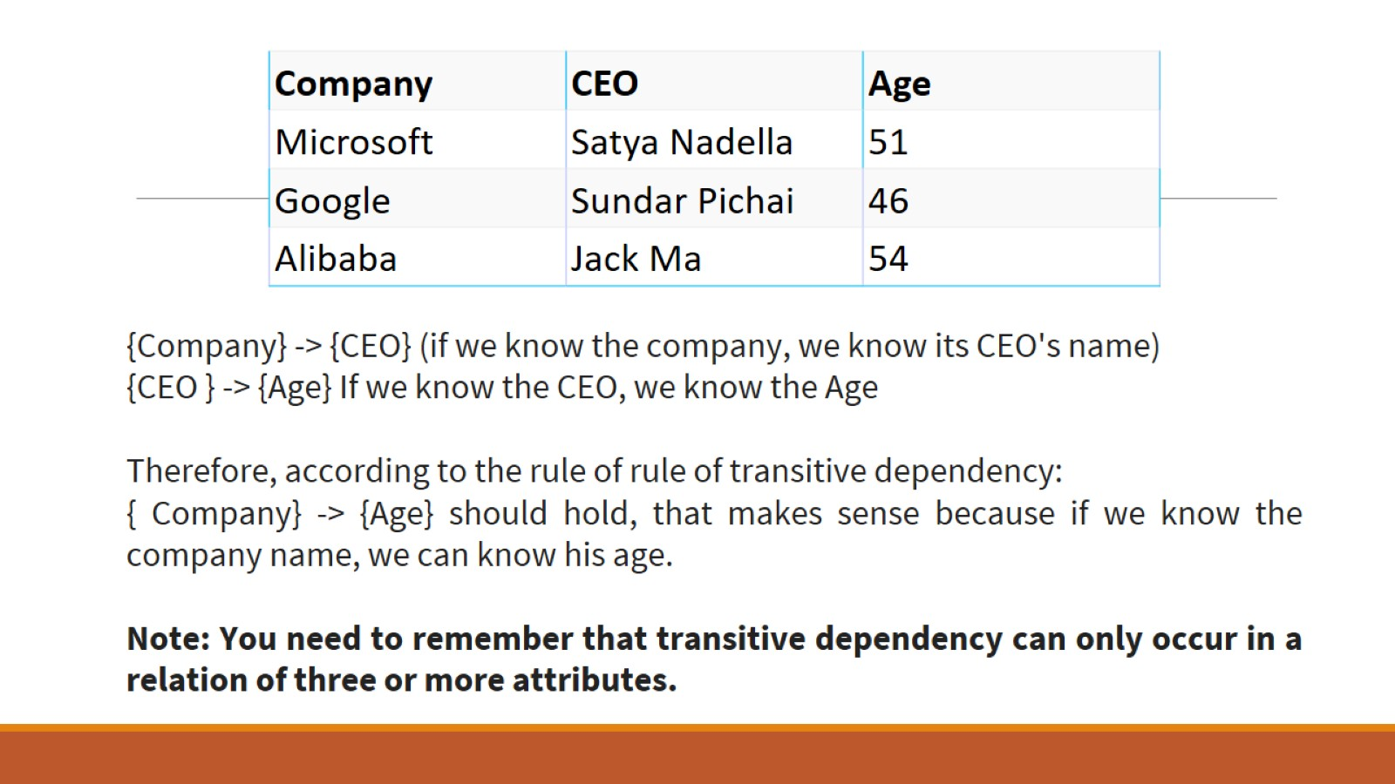

Slide 9
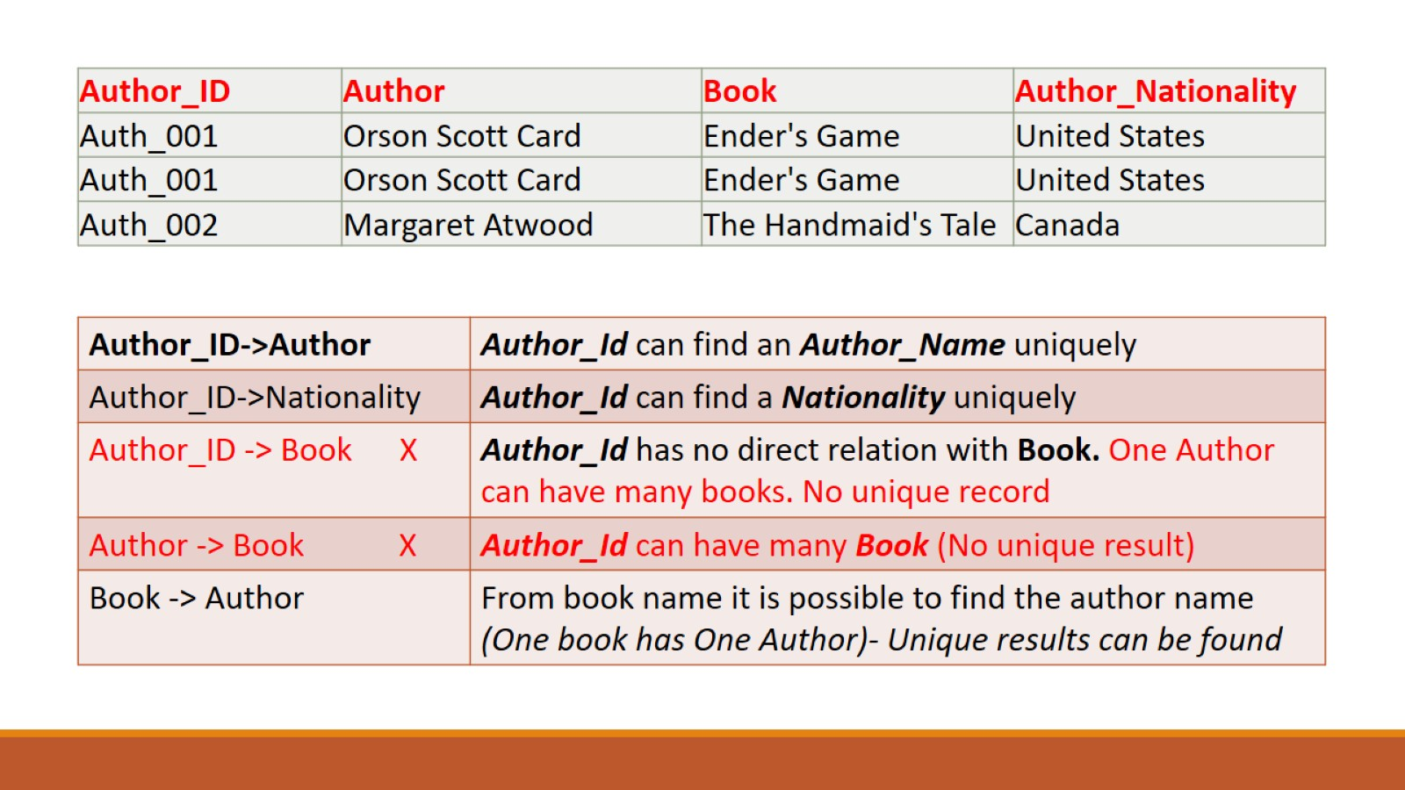

Slide 10
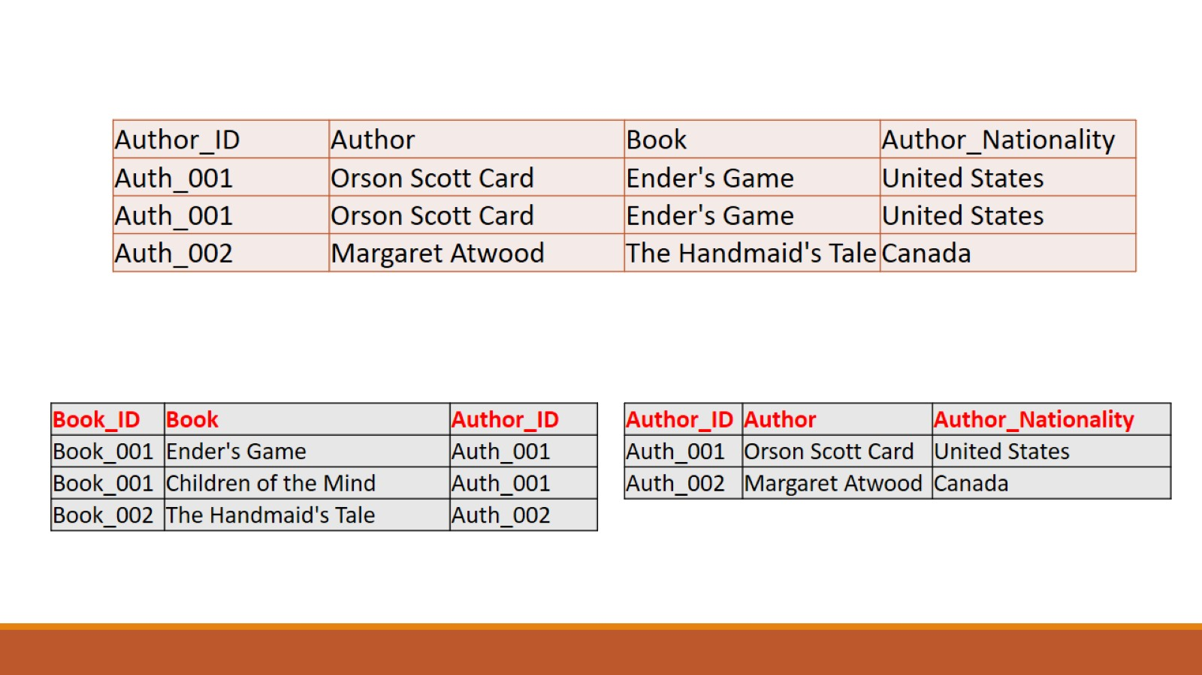

Slide 11
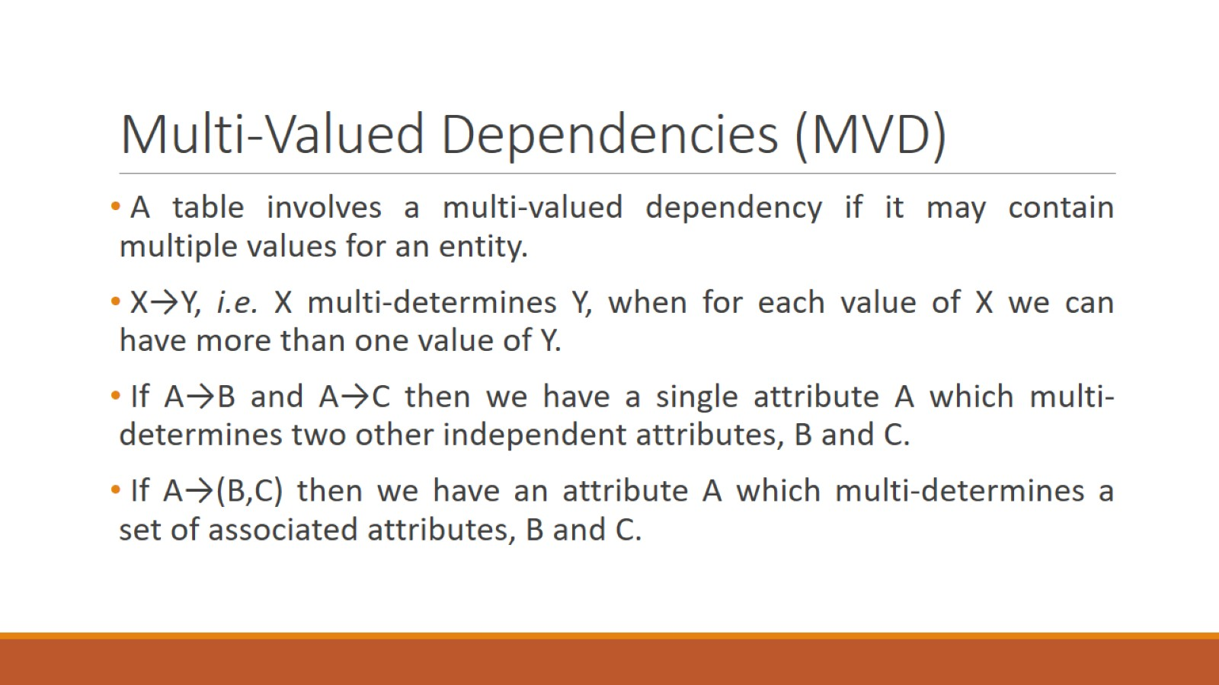
Multi-Valued Dependencies (MVD)

Slide 12
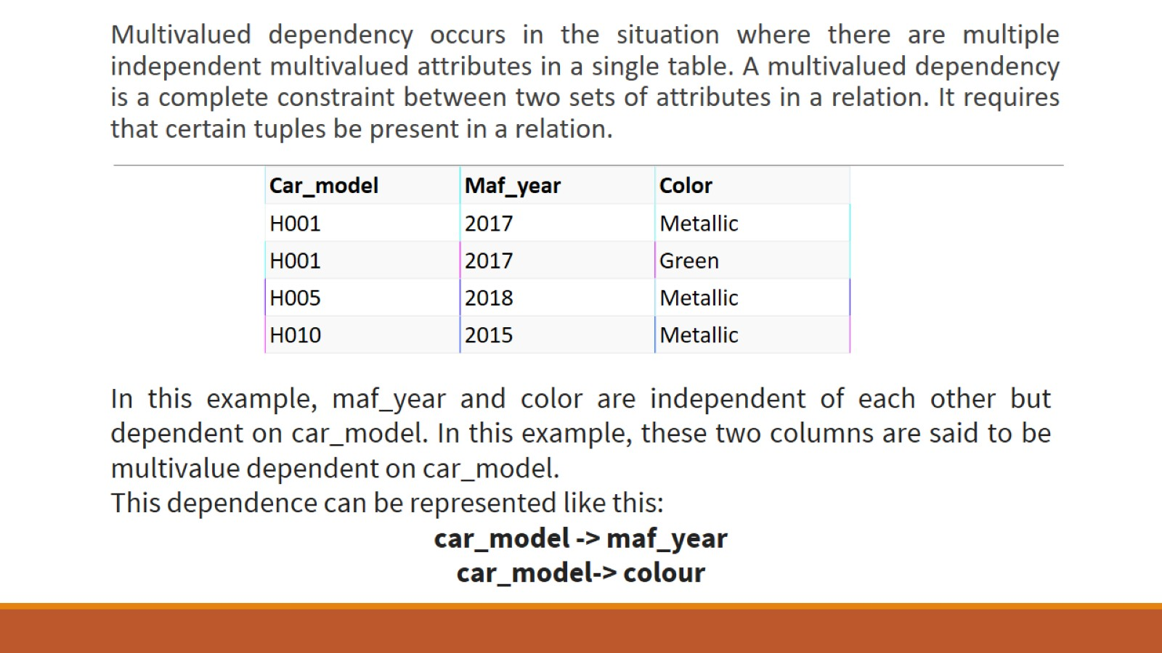

Slide 13
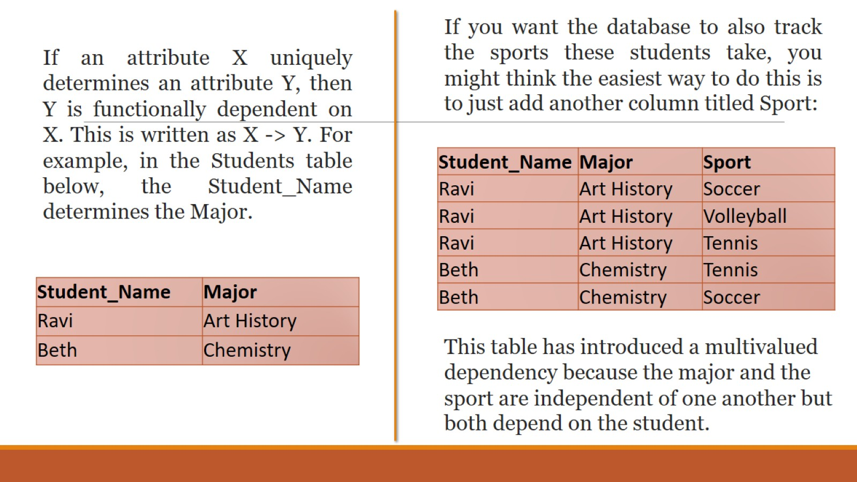

Slide 14
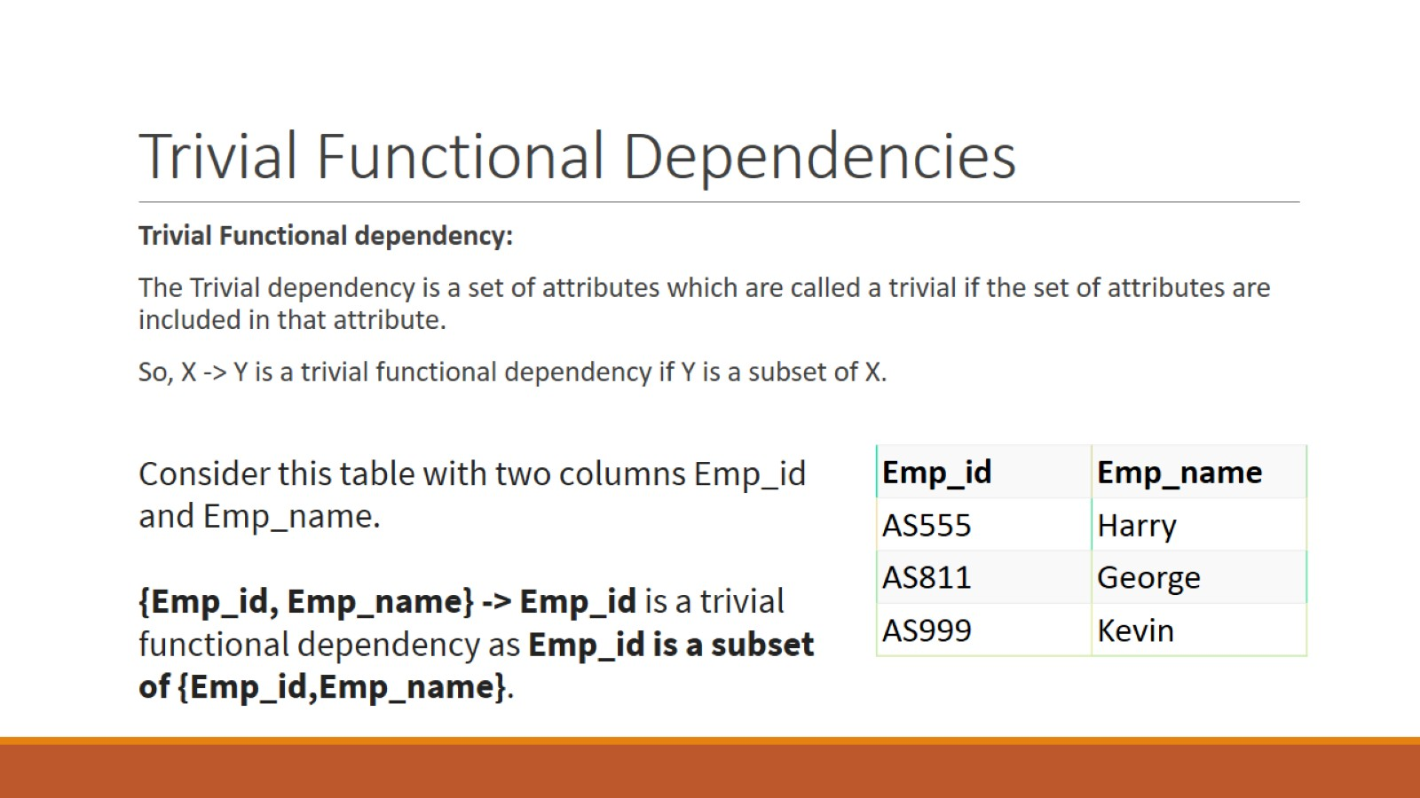
Trivial Functional Dependencies

Slide 15
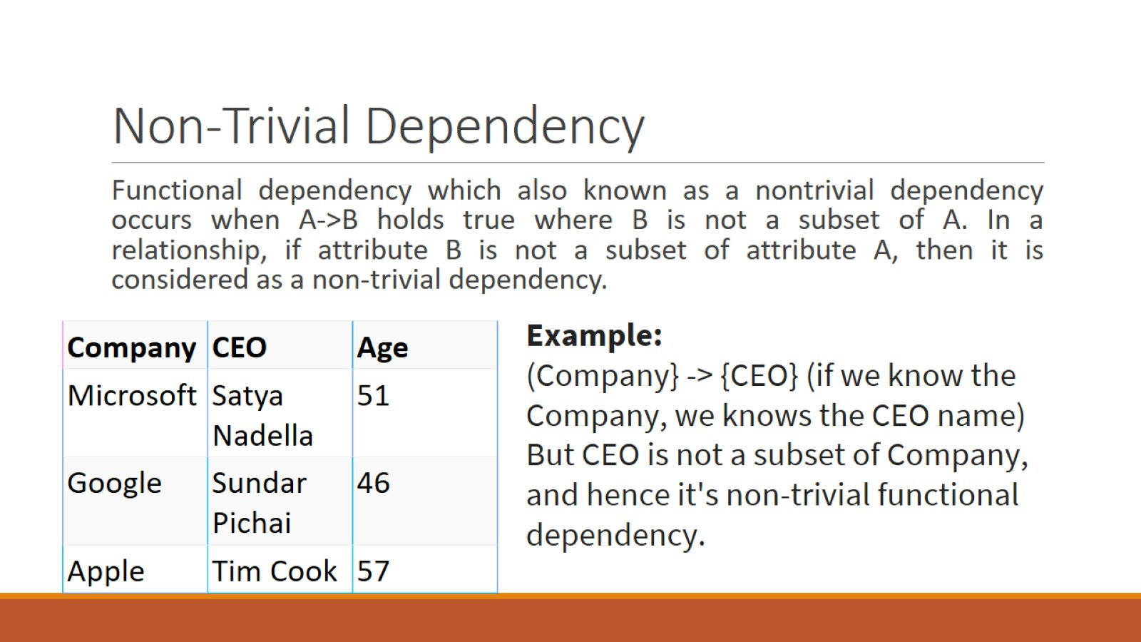
Non-Trivial Dependency

Slide 16

NORMALIZATION

Slide 17
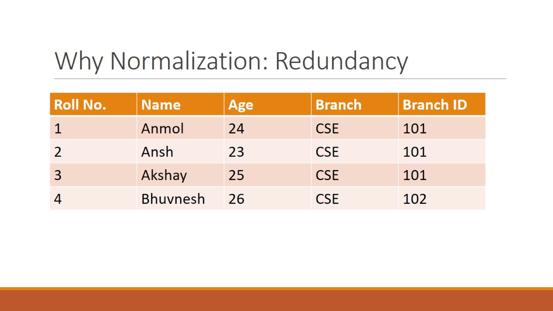
Why Normalization: Redundancy

Slide 18
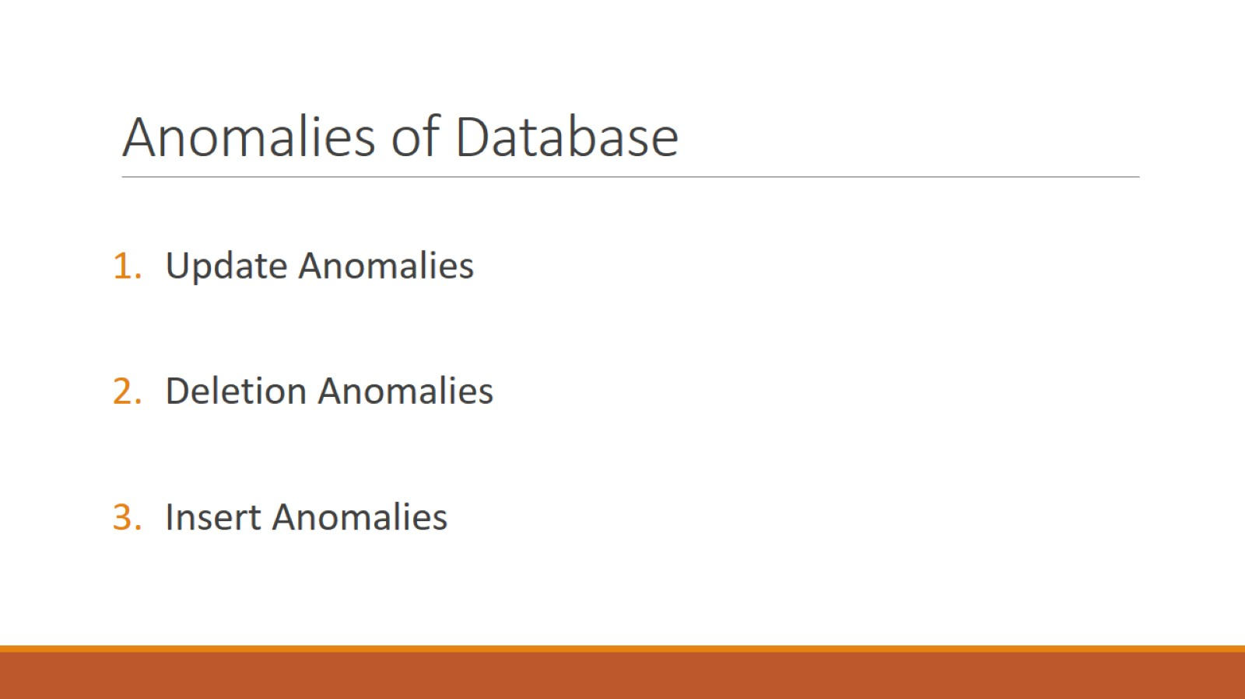
Anomalies of Database

Slide 19
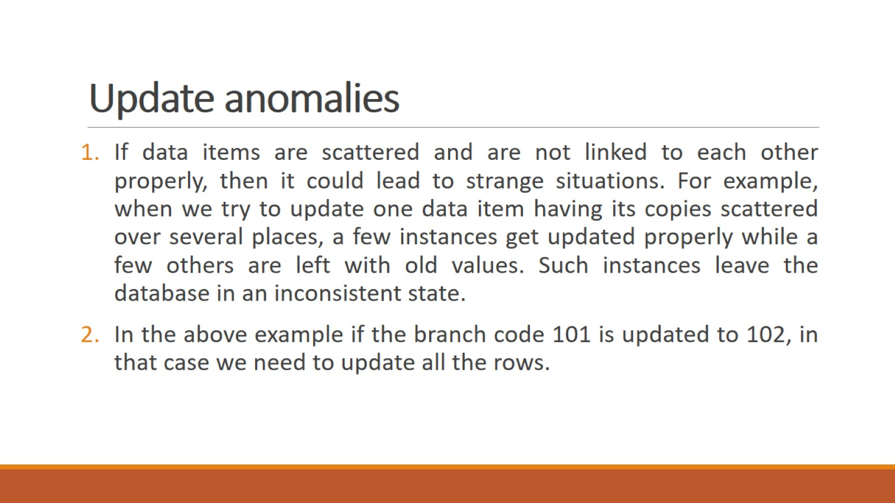
Update anomalies

Slide 20
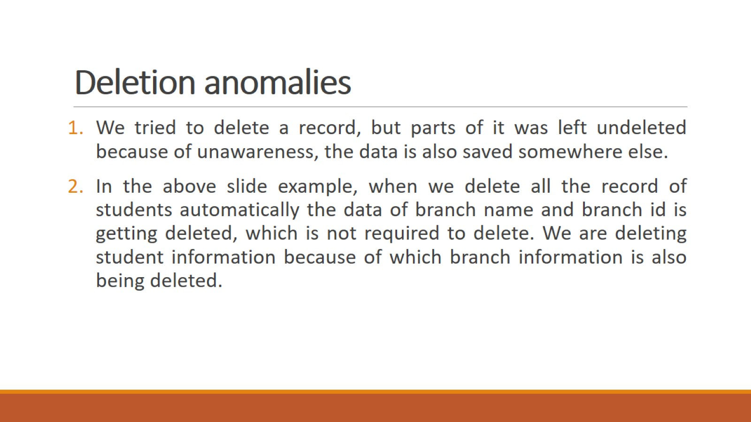
Deletion anomalies

Slide 21
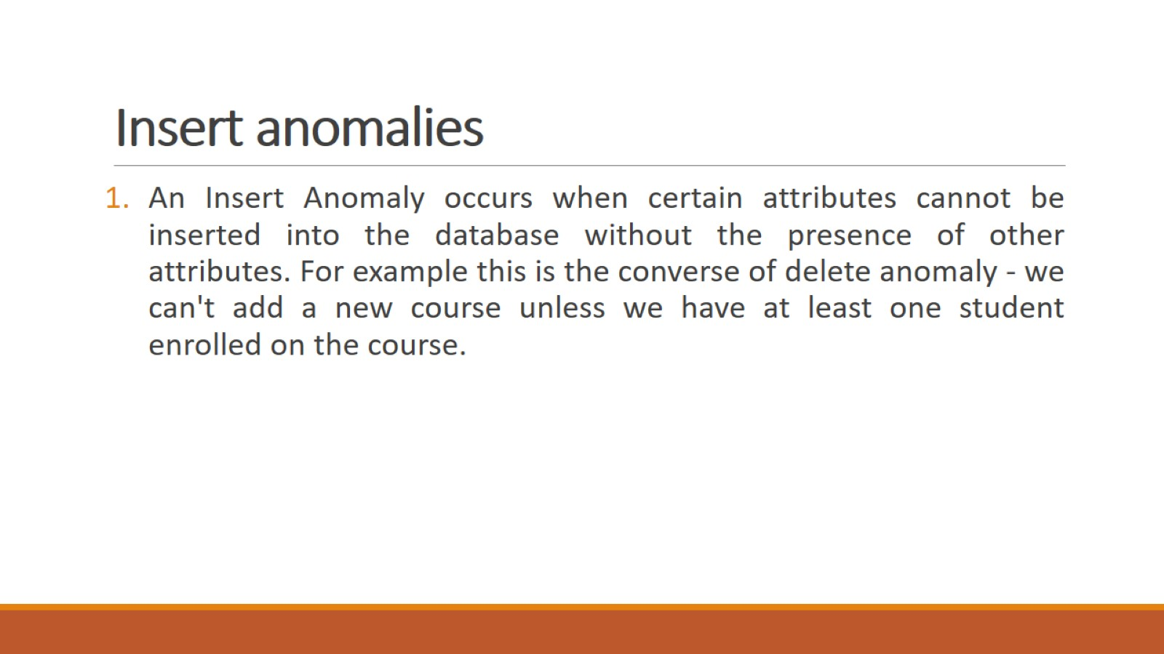
Insert anomalies

Slide 22
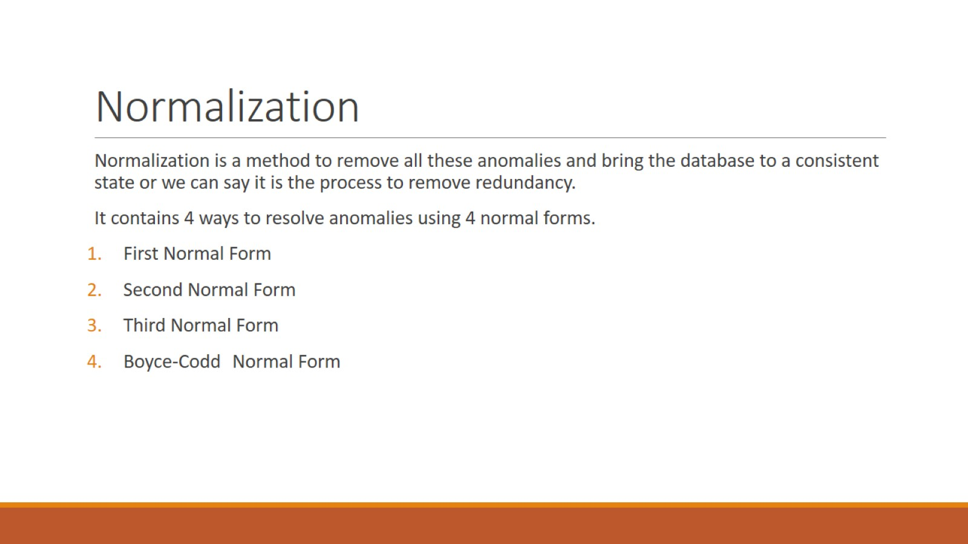
Normalization

Slide 23
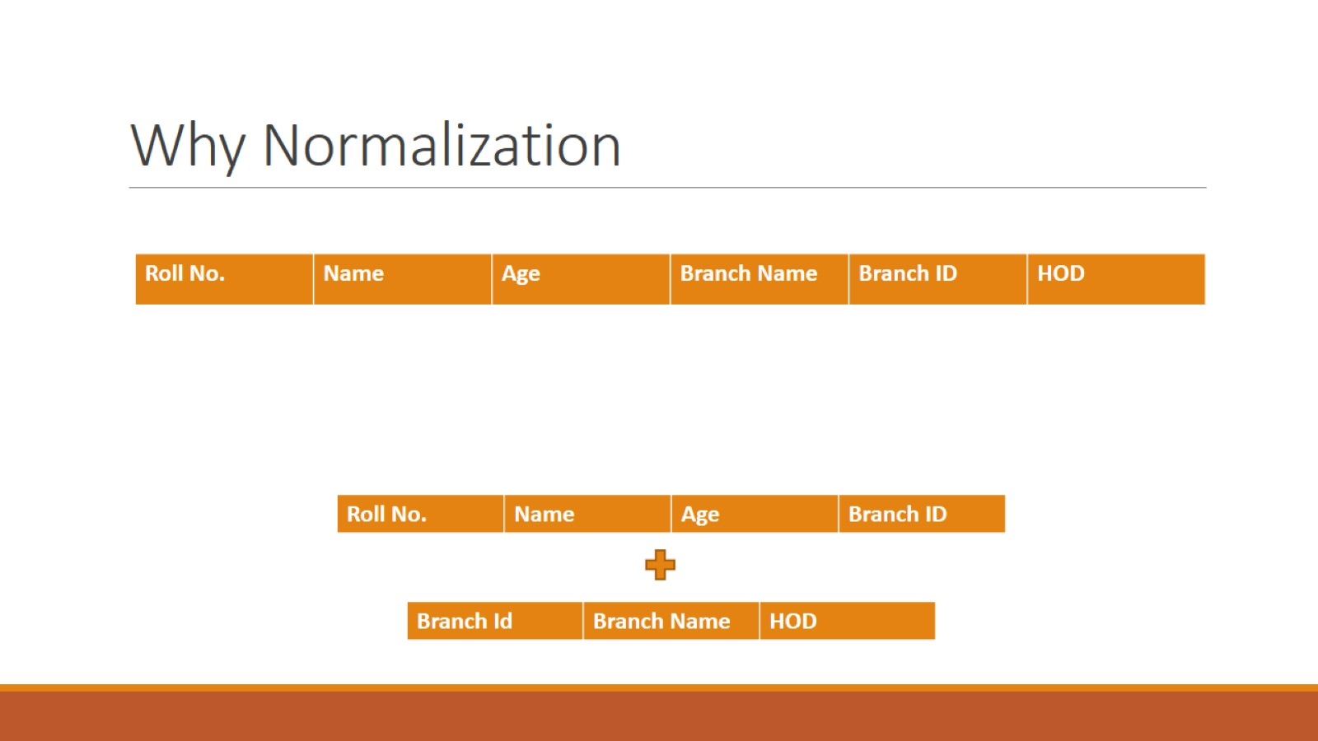
Why Normalization

Slide 24
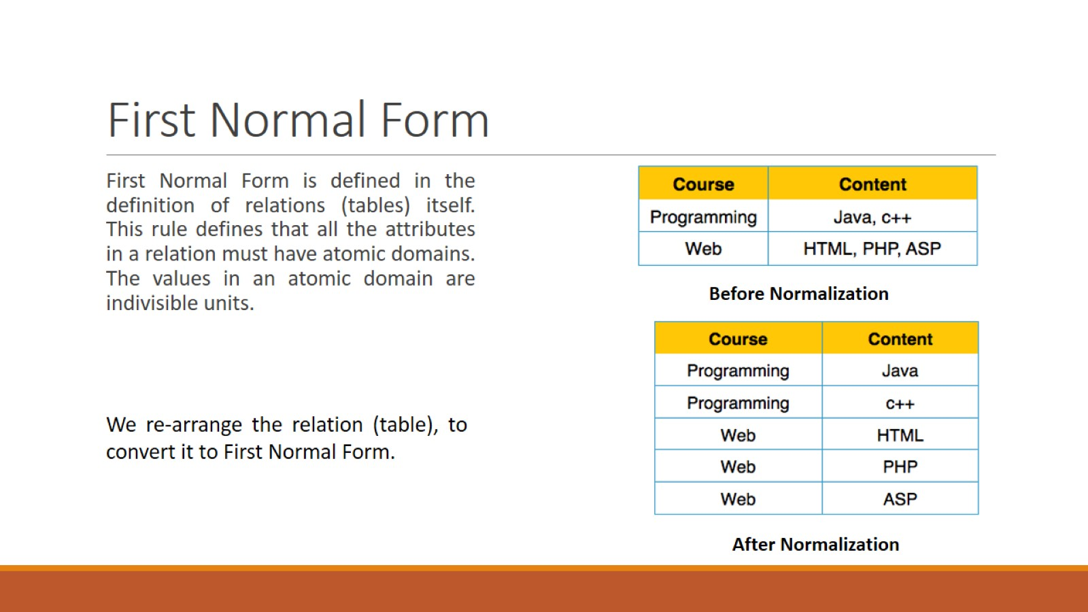
First Normal Form

Slide 25
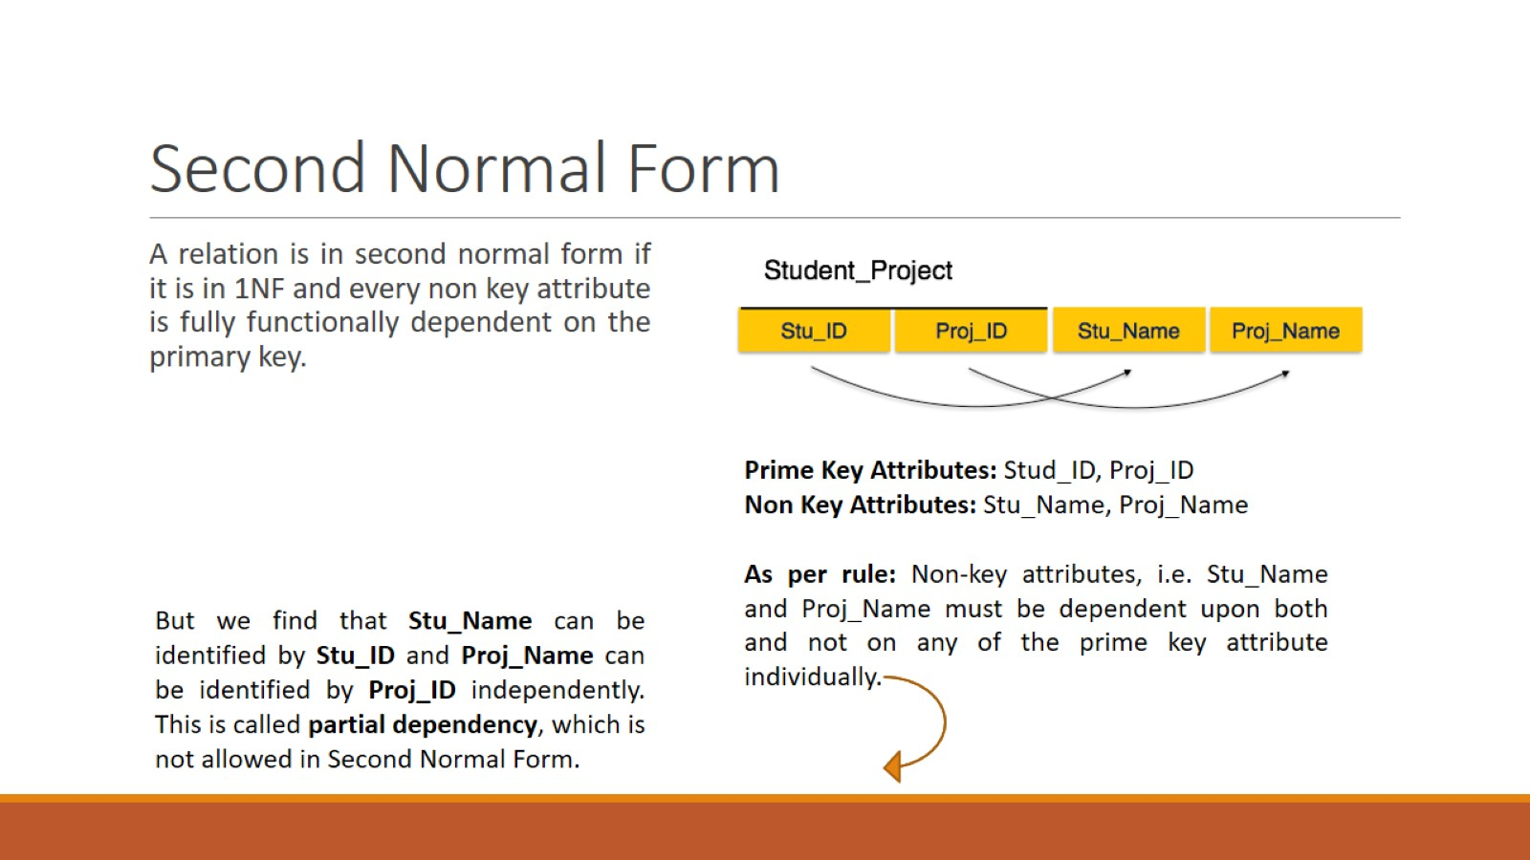
Second Normal Form

Slide 26
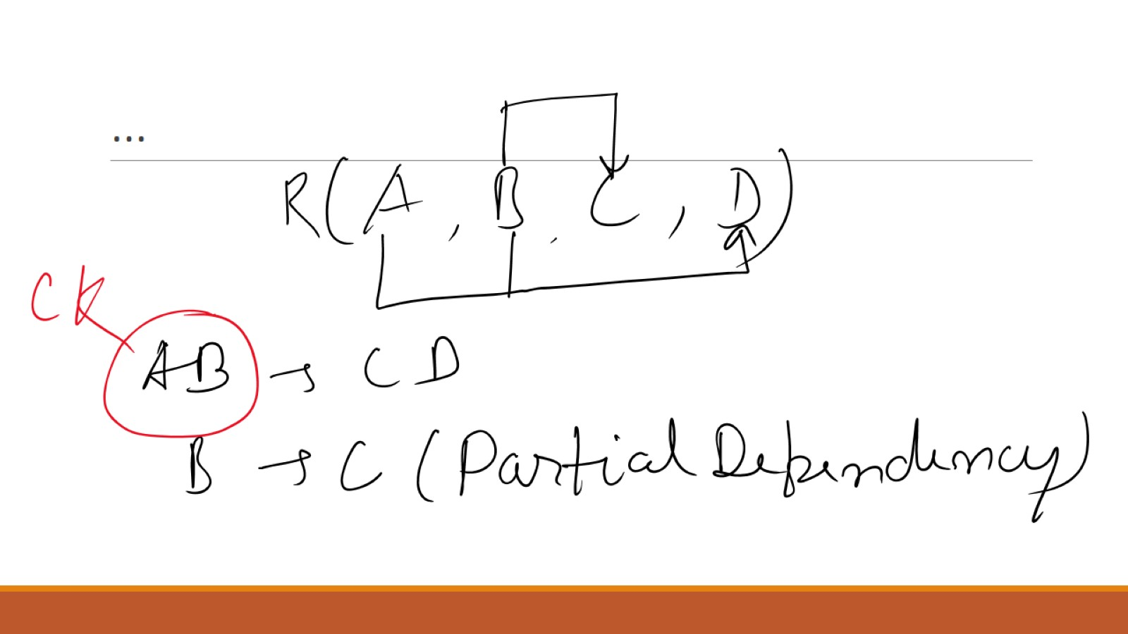
…

Slide 27
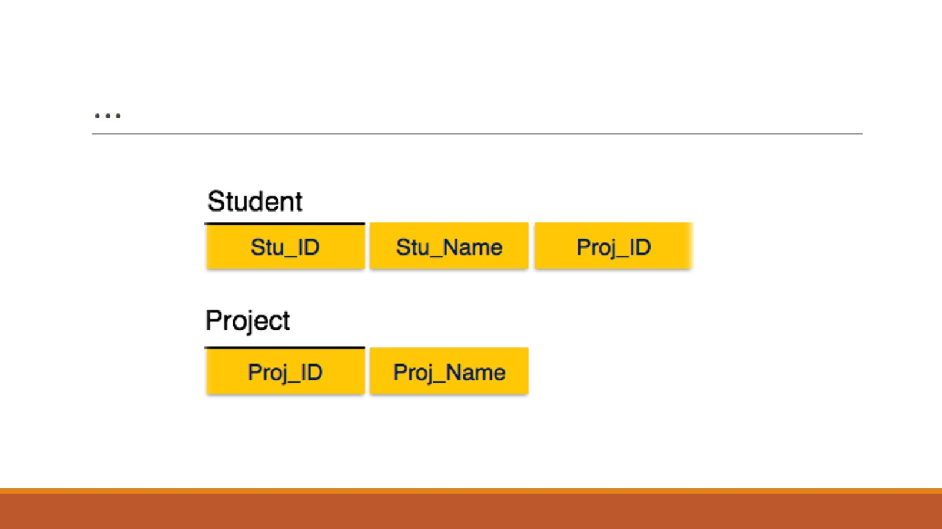
…

Slide 28
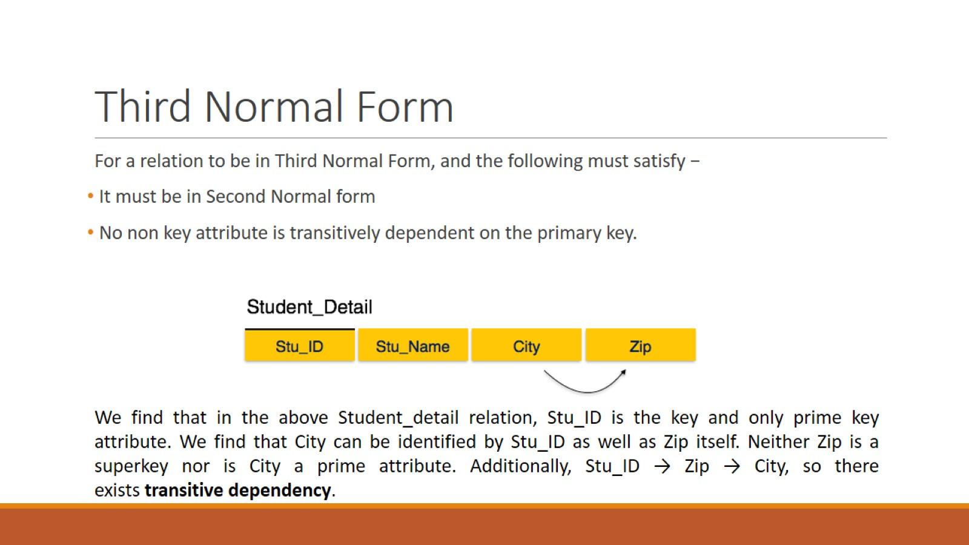
Third Normal Form

Slide 29
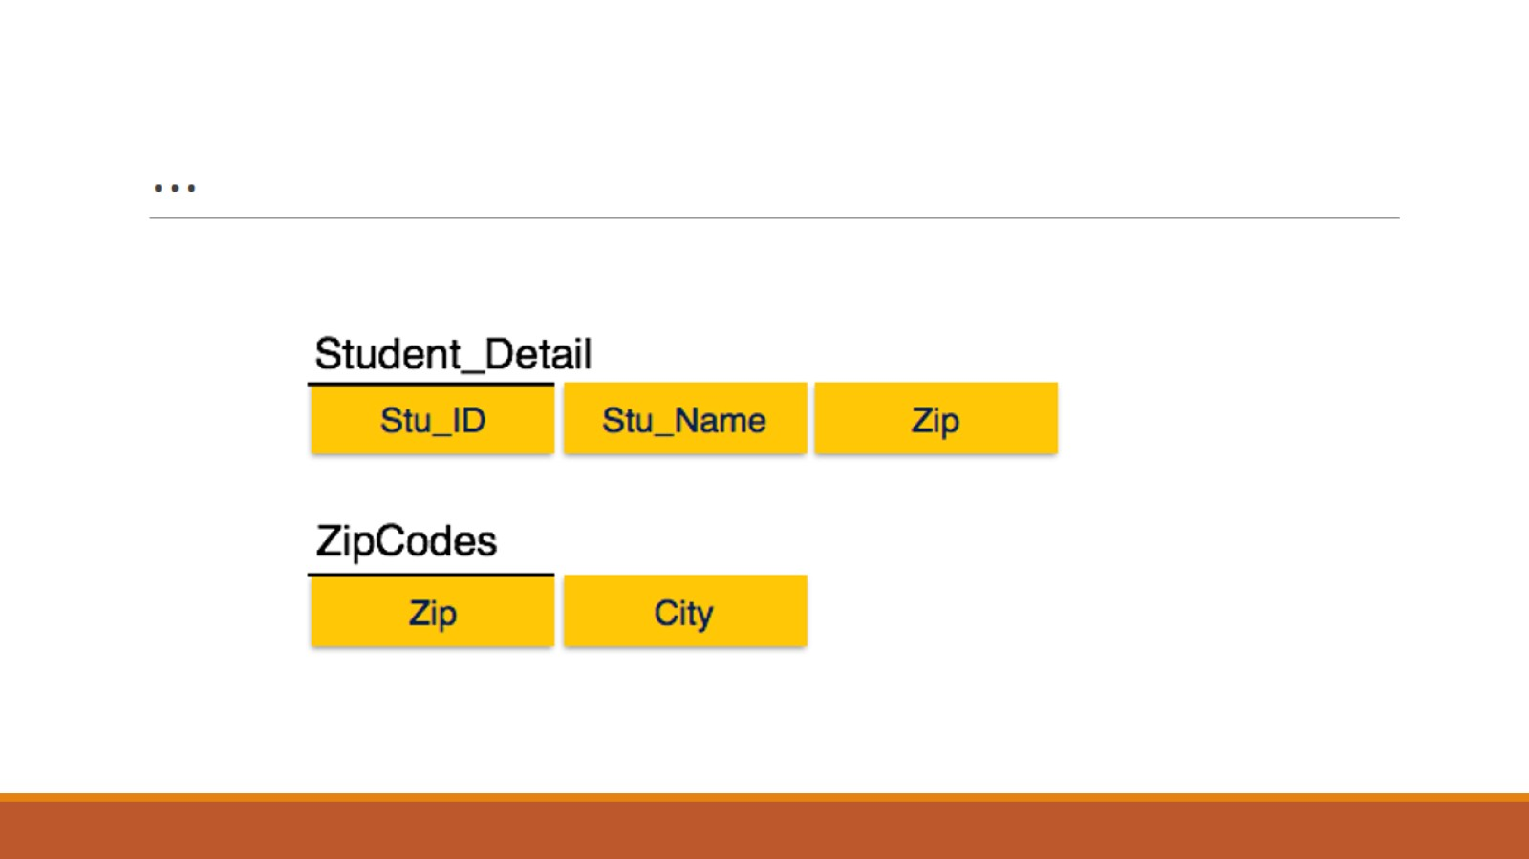
…

Slide 30
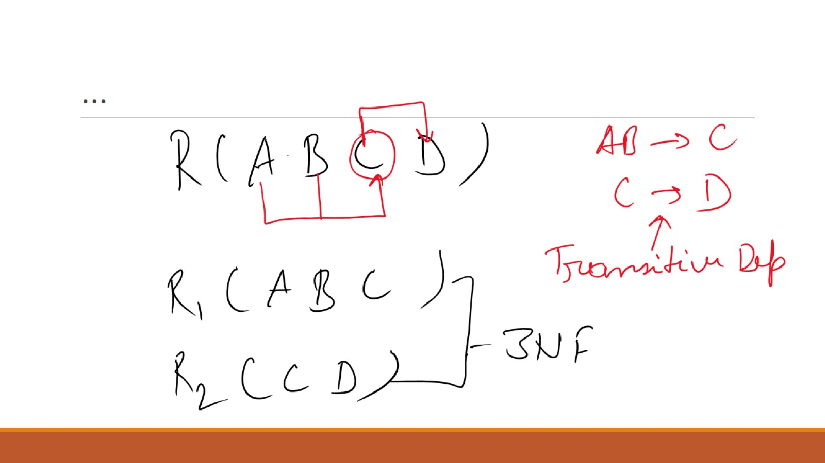
…

Slide 31
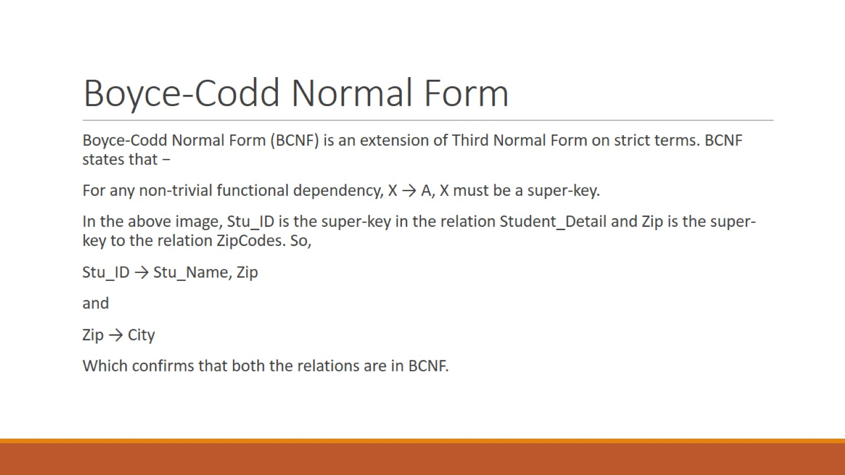
Boyce-Codd Normal Form

Slide 32
BCNF
Boyce–Codd Normal Form (BCNF) is a stronger version of the Third Normal Form (3NF) used to eliminate redundancy and anomalies in database tables.
Rule of BCNF:
A table is in BCNF if: For every non-trivial functional dependency X → Y, X must be a super key.
Meaning:
The attribute (or set of attributes) determining other attributes must be a candidate key or super key.

Slide 33
…
Student | Course | Instructor
A | DBMS | Dr. Rao
B | AI | Dr. Sharma
C | DBMS | Dr. Rao
Functional dependencies:
Student, Course → Instructor
Instructor → Course
Here Instructor determines Course, but Instructor is not a super key, so the table violates BCNF.

Slide 34
Decomposition to BCNF
Split into two tables:
Table 1
Student | Instructor
A | Dr. Rao
B | Dr. Sharma
C | Dr. Rao
Table 2
Instructor | Course
Dr. Rao | DBMS
Dr. Sharma | AI
Now both tables satisfy BCNF.

Slide 35
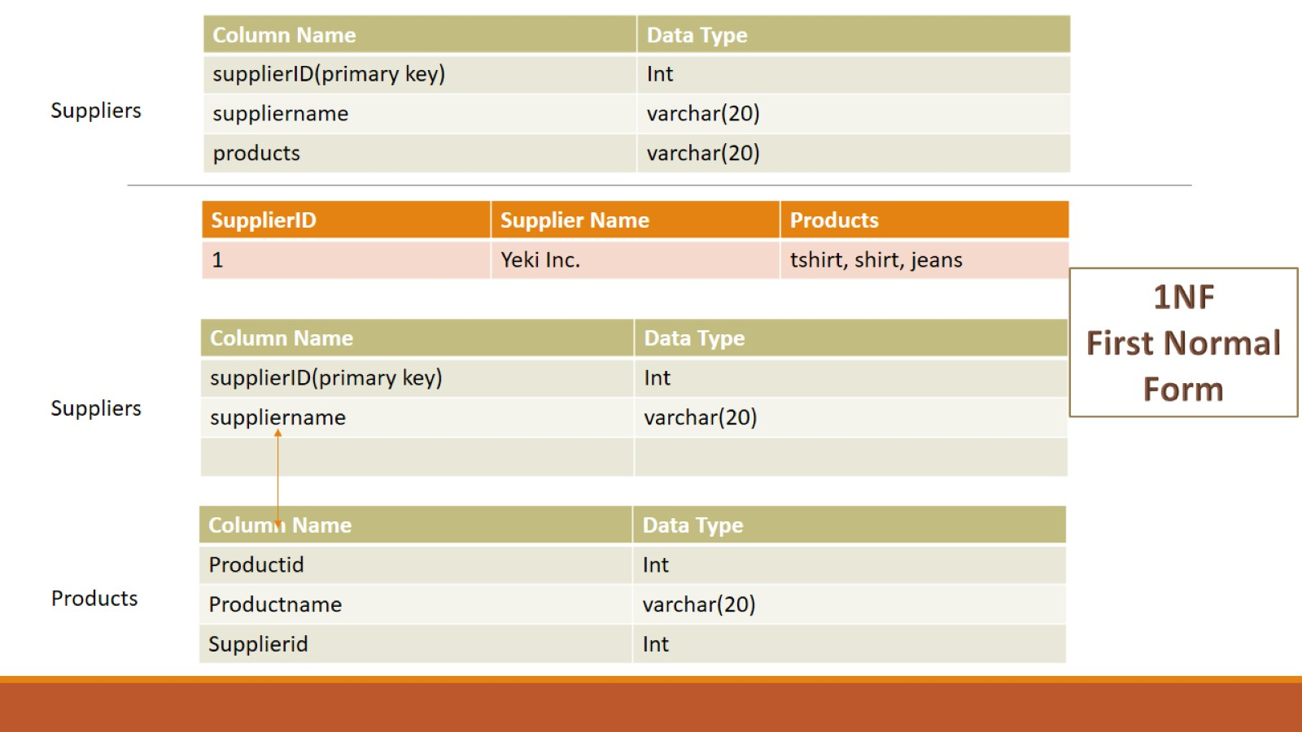

Slide 36
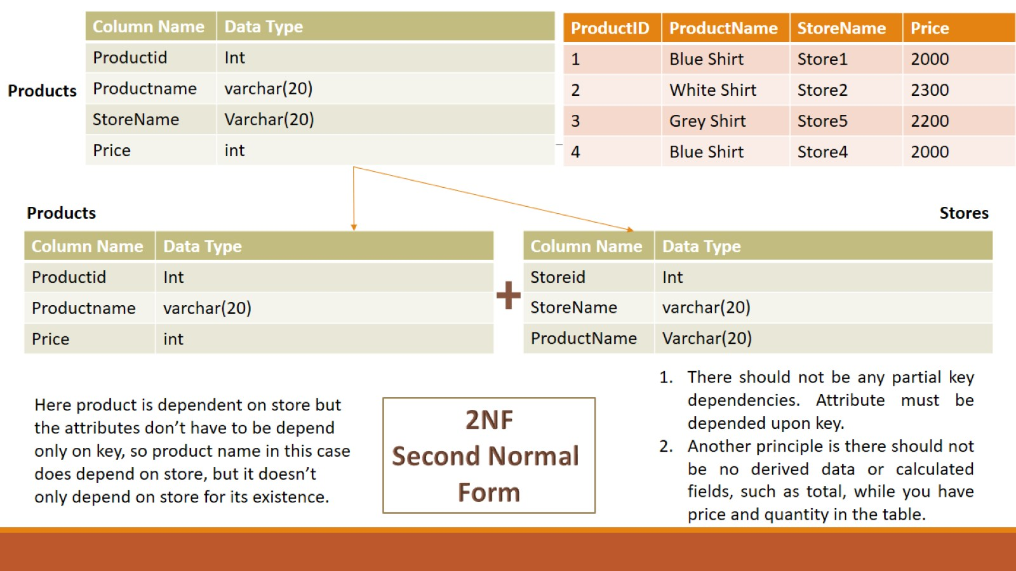

Slide 37
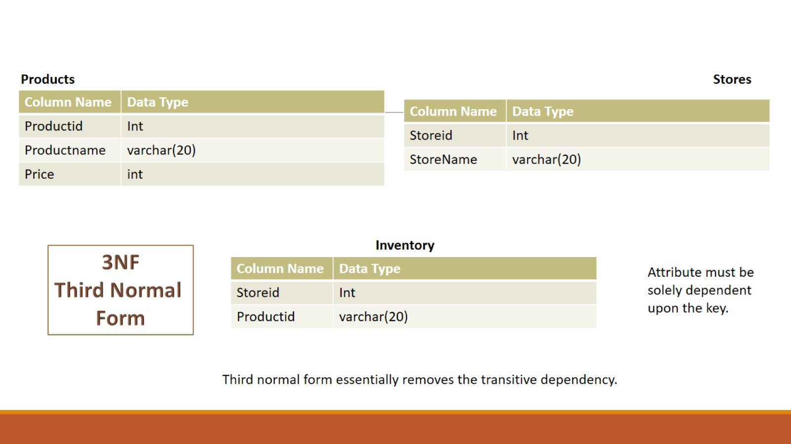

Slide 38
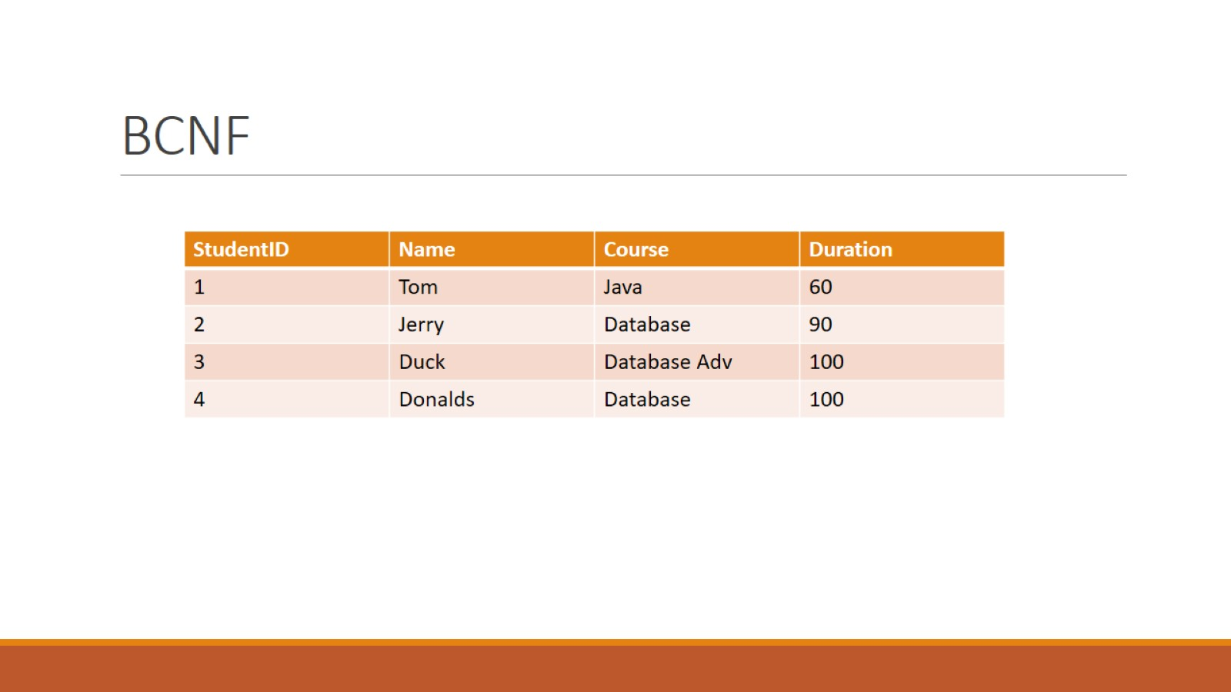
BCNF

Slide 39
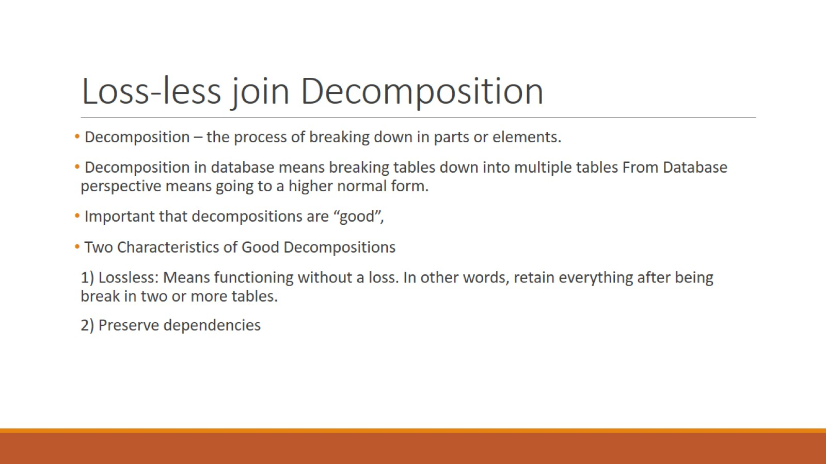
Loss-less join Decomposition

Slide 40
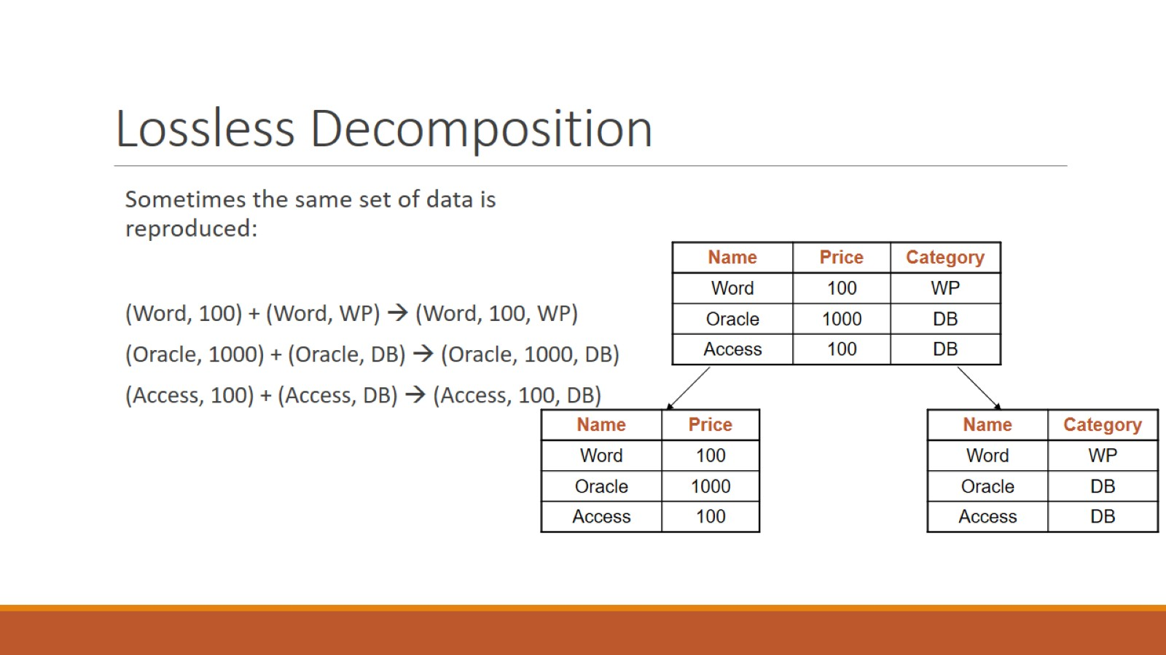
Lossless Decomposition

Slide 41
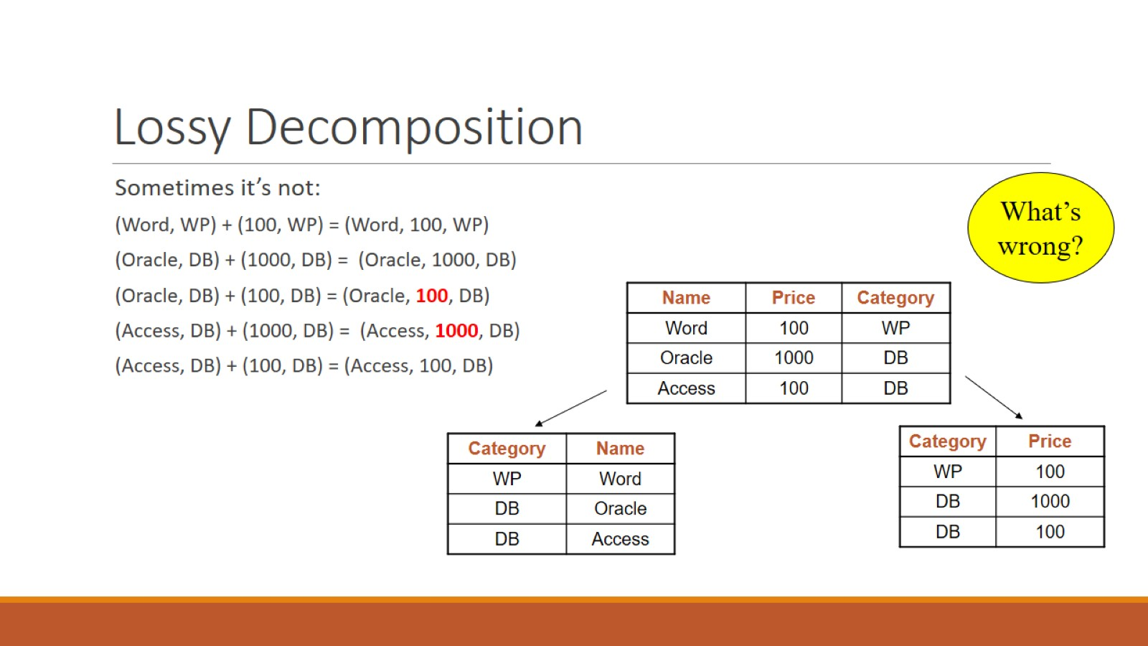
Lossy Decomposition

Slide 42


